Slide 1

2nd NECCC Mini Series:
Altered Reality Competitions
By the NECCC Panel on Altered Reality Competitions
Bill Barnett, Jim Brady, Rick Cloran, Lisa Cuchara, Antoinette Gombeda,
Mike Goodman, Cindy Gosselin, Hazel Meredith, Shiv Verma
Copyright © 2024 NECCC. All rights reserved.

Slide 2
Goal of This Presentation
Review findings from the recent NECCC survey
Provide information and suggestions to help member clubs
  Understand this category of images
  Introduction to the tools and techniques used to create these images
  Decide which tools and techniques you want to allow in your competitions
  Develop rules for how these competitions will be run at your club
  Write specific competition guidelines that help your members comply with the rules
  Write clear instructions for how your club wants these competitions to be judged

Slide 3
Some Clubs Have Them, Some Clubs Don’t
NECCC surveyed member camera clubs
Survey says:
  Some clubs don’t run any competitions
  About half run some form of altered reality competition
  Some are curious about starting altered reality competitions
  Others are reluctant to start altered reality competitions
In other words, there’s very little common ground
Provide a presentation that could provide that common ground

Slide 4
This Presentation Offers Suggestions
The suggestions in this program are influenced by
  NECCC’s recent survey of member clubs
  Best practices from PSA and other Councils around the country
  A panel of experienced photographers and judges from New England
We hope clubs will be better able to
  Decide what you want in your Altered Reality competitions
  Provide your members with clear written guidelines/rules
  Write clear and detailed instructions for judges

Slide 5
Part One: What Is an
Altered Reality Competition?

Slide 6
What’s In a Name?
Different clubs use different titles for these competitions
  Creative - too general; most photographers strive for creative images
  Manipulated - nearly all digital images are manipulated
  Abstract - too restrictive, not all AR images are abstract
NECCC suggests using “Altered Reality (AR)”
  This is based on the definition of what an AR image is (in the next slide)
  We also want to make a clear distinction between AR and Artificial Intelligence (AI)

Slide 7
What Is an Altered Reality Image?
Based on input from PSA and other Councils, an AR image should
  Obviously display a change of
    Natural color
    Form
    Texture
    Appearance
    …or any combination of these
  These changes should result in
  an image that no longer resembles what we are used to seeing
  These changes should be readily apparent to the viewer
The “not a true nor realistic representation of reality” must be obvious

Slide 8
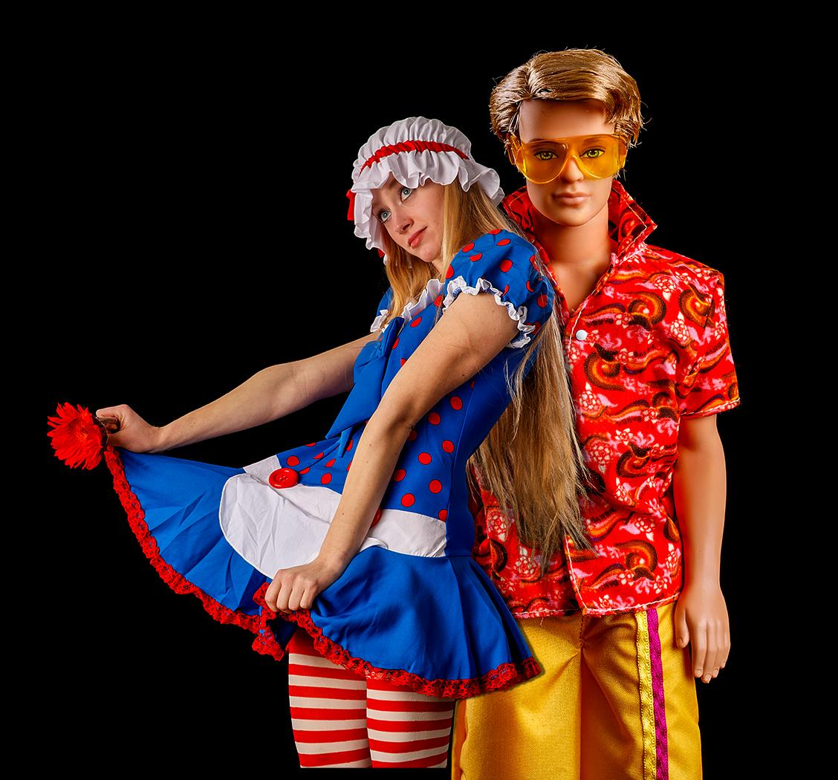
II-A: An AR image can be SIMPLE (Jim Brady)

Slide 9
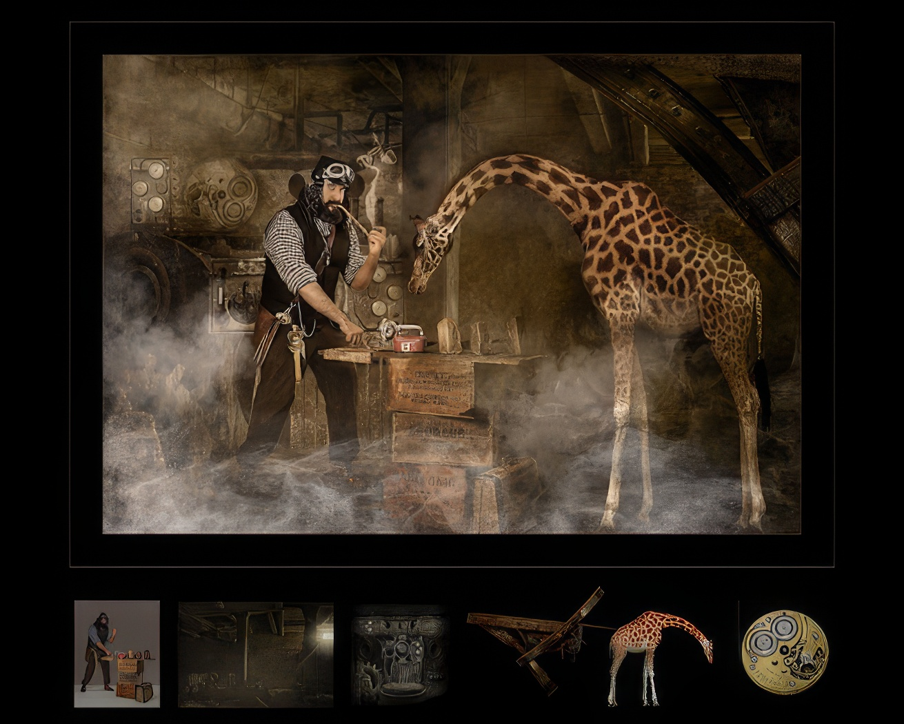
II-B: But most successful AR images are usually COMPLEX (Lisa Cuchara)
This is an example of a Composite image…made up of several visual elements.

Slide 10

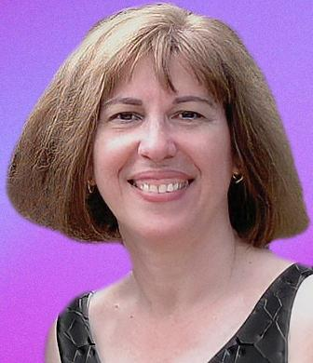
My style is experimental using an elegant interplay of form, line, texture, and color to shape and tell a story.
II-C: Some AR images can be quite ethereal (Nanda Hrul)
Without a recognizable element, a judge might have difficulty assessing the image.

Slide 11
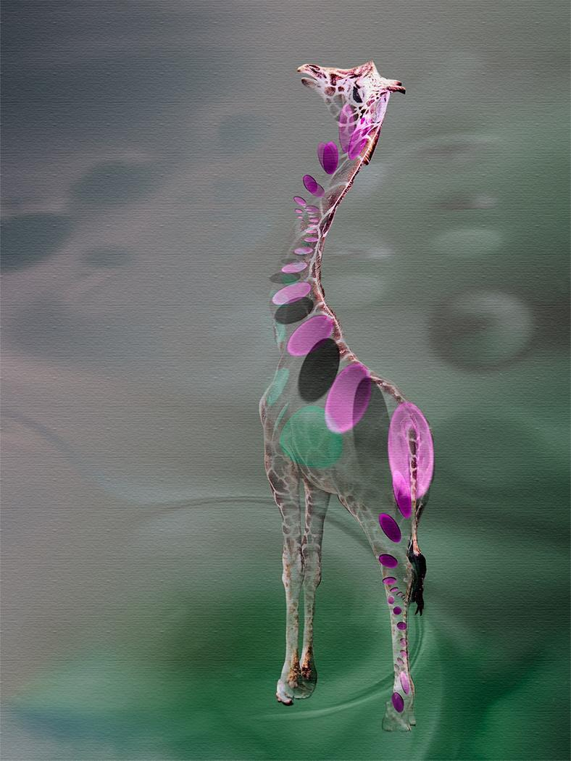
II-D: A recognizable feature helps the viewer understand the image (Nanda)
Including some recognizable element helps a judge relate to the image.

Slide 12
How Does One Judge an AR Image
Some judges seem to have a hard time judging these competitions
We suggest that you write clear instructions to manage judging
  Judges should not be concerned with how an image is created
  Judging should be based on the basic elements of
    Impact
    Emotion
    Composition
    Technical merit
  …just like any other image
There is much more guidance on judging in the 14-page Altered Reality Competition Guide available on the NECCC website
NECCC will hold another Mini Series to cover judging AR Competitions

Slide 13
Part Two: Suggestions For
Tools and Techniques to Allow

Slide 14
Which Techniques Can Be Used to Make AR Images?
There are many in-camera and post production tools
and techniques that makers use for AR images
Following are NECCC’s recommendations for
which techniques to allow and not allow
After you decide which techniques to adopt for your club,
we urge you to write clear guidelines for your members
Your guidelines for members can also inform
your written instructions to judges

Slide 15
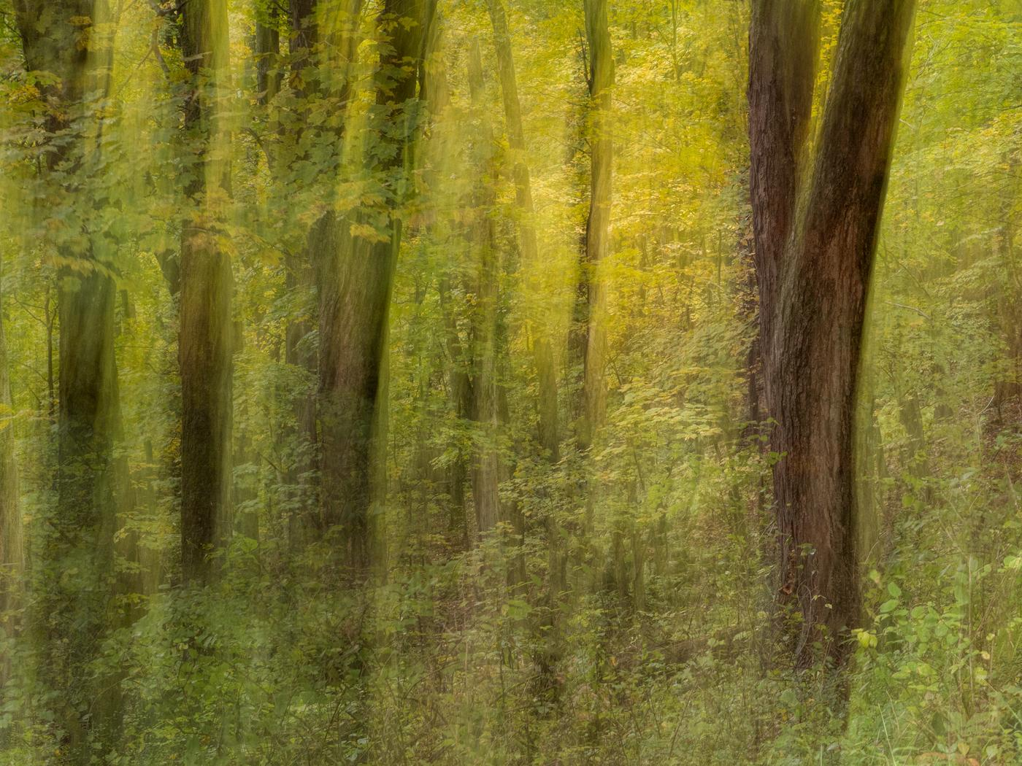
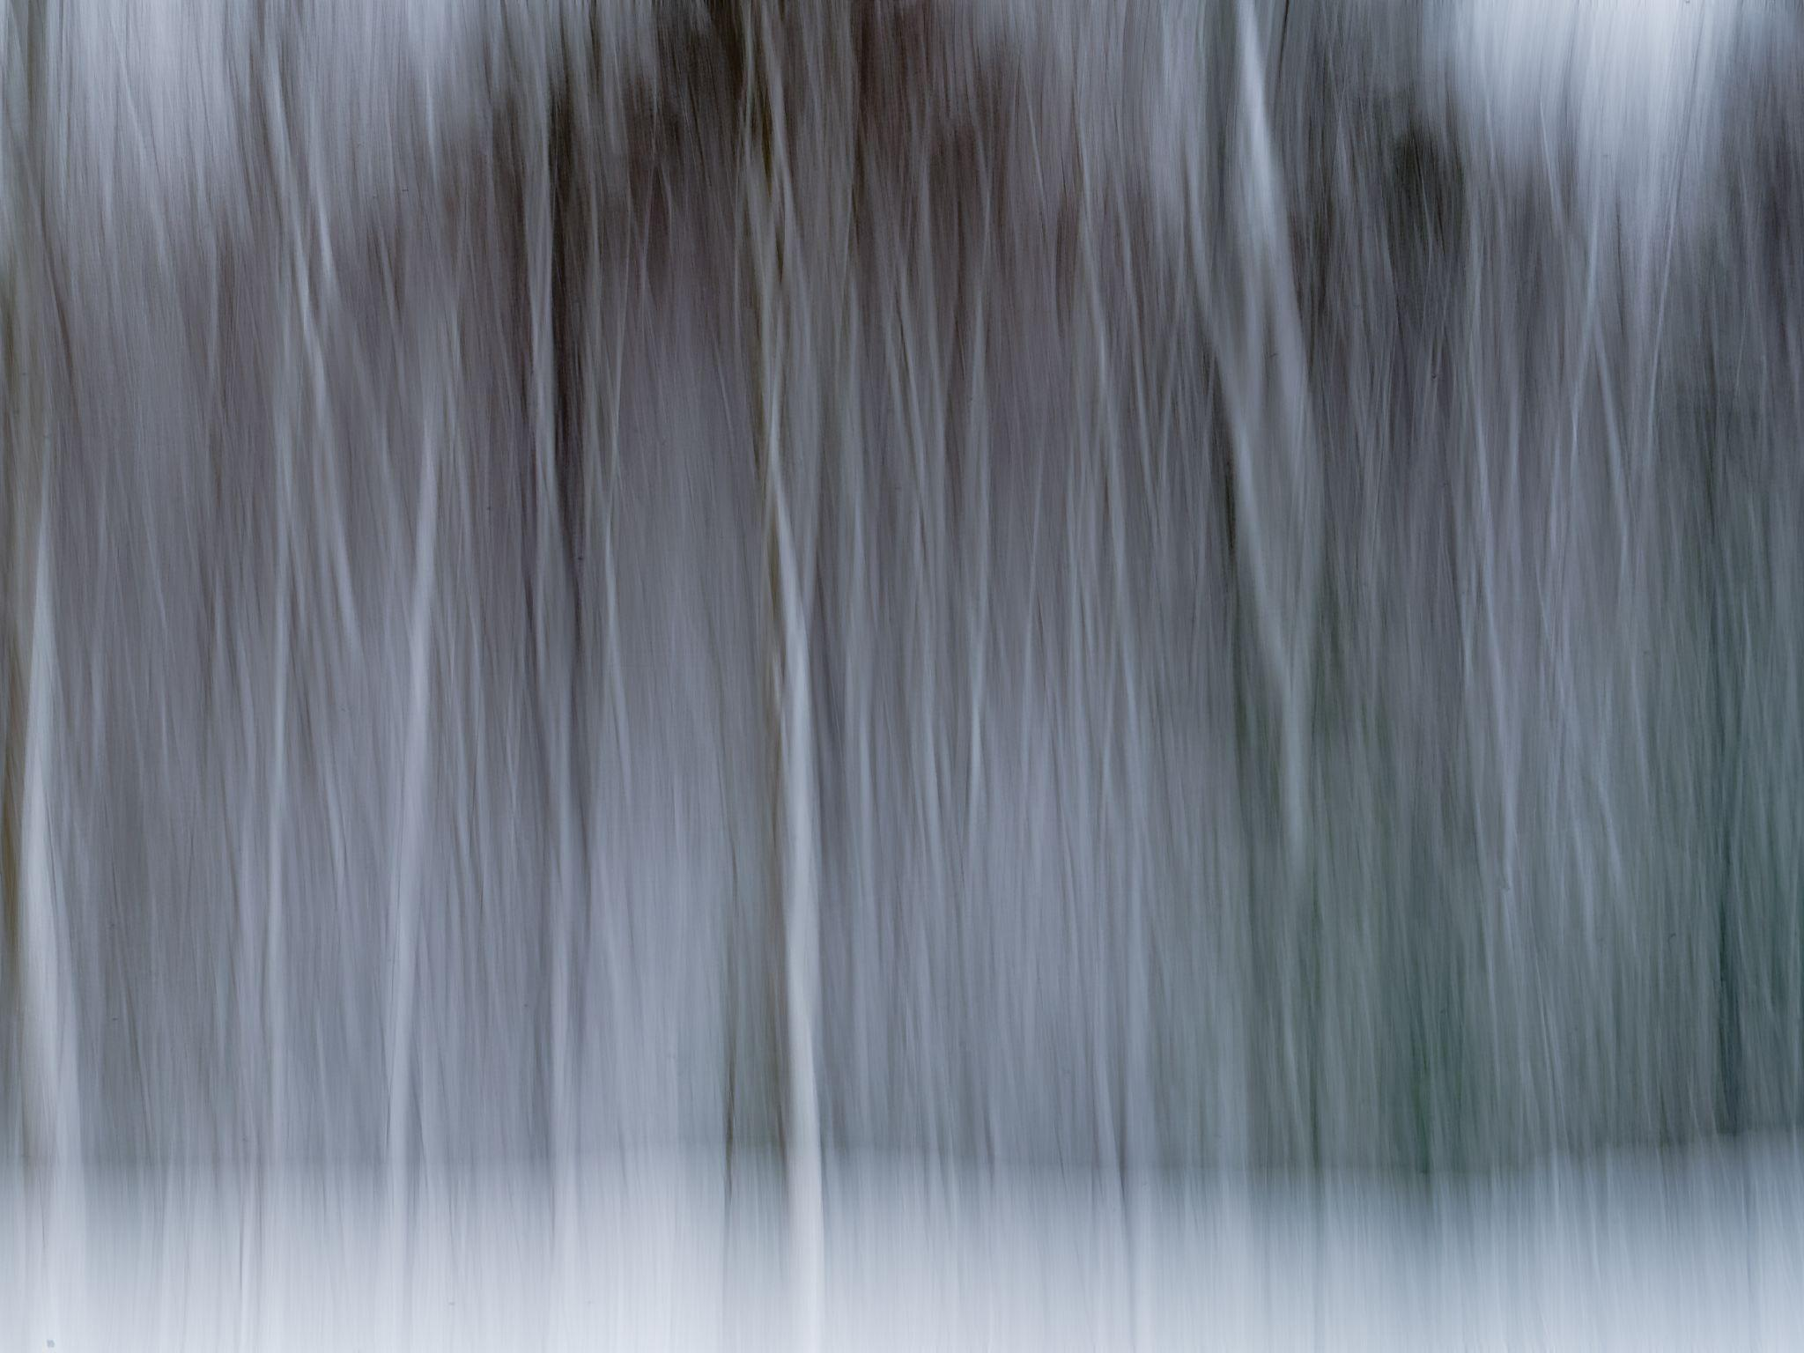
Allow: Intentional Camera Movement (ICM)
III-1A: ICM - No post production needed (Cindy Gosselin, Jim)

Slide 16
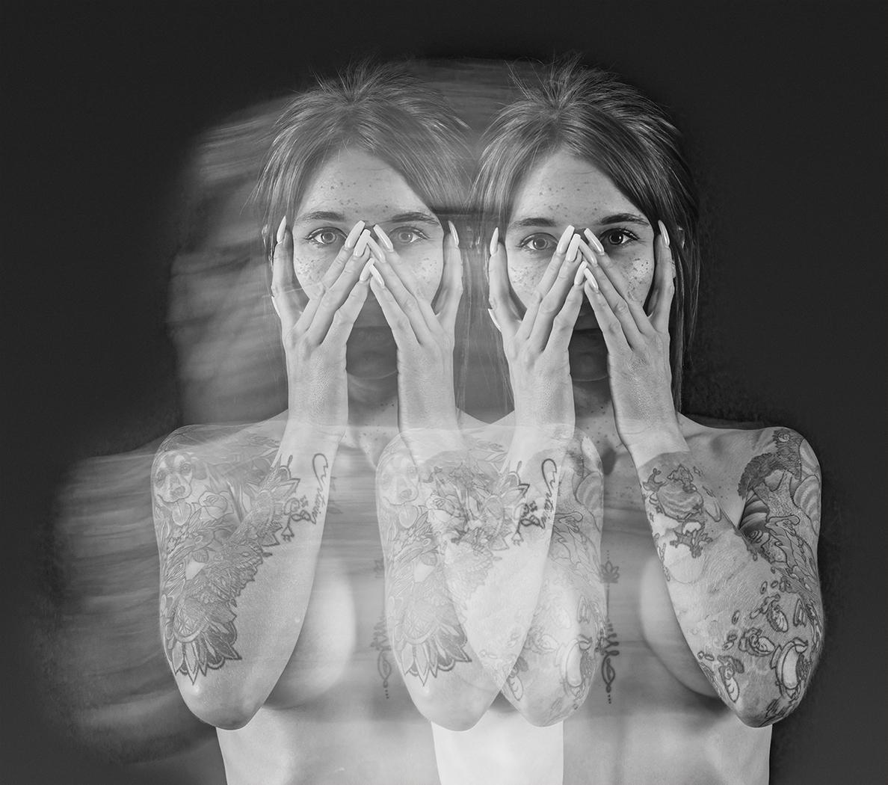
Allow: In-Camera Multiple Exposure (ICME)
III-2A: Multiple exposures on one frame - No post production needed (Jim)

Slide 17

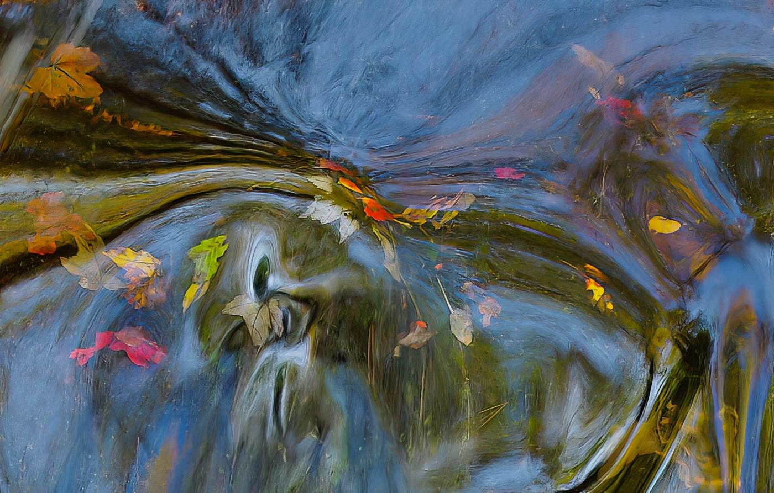
Allow: Abstract Subject Matter
III-3A: Straight out of camera or created in post (John Gill, Charlene Gaboriault)

Slide 18
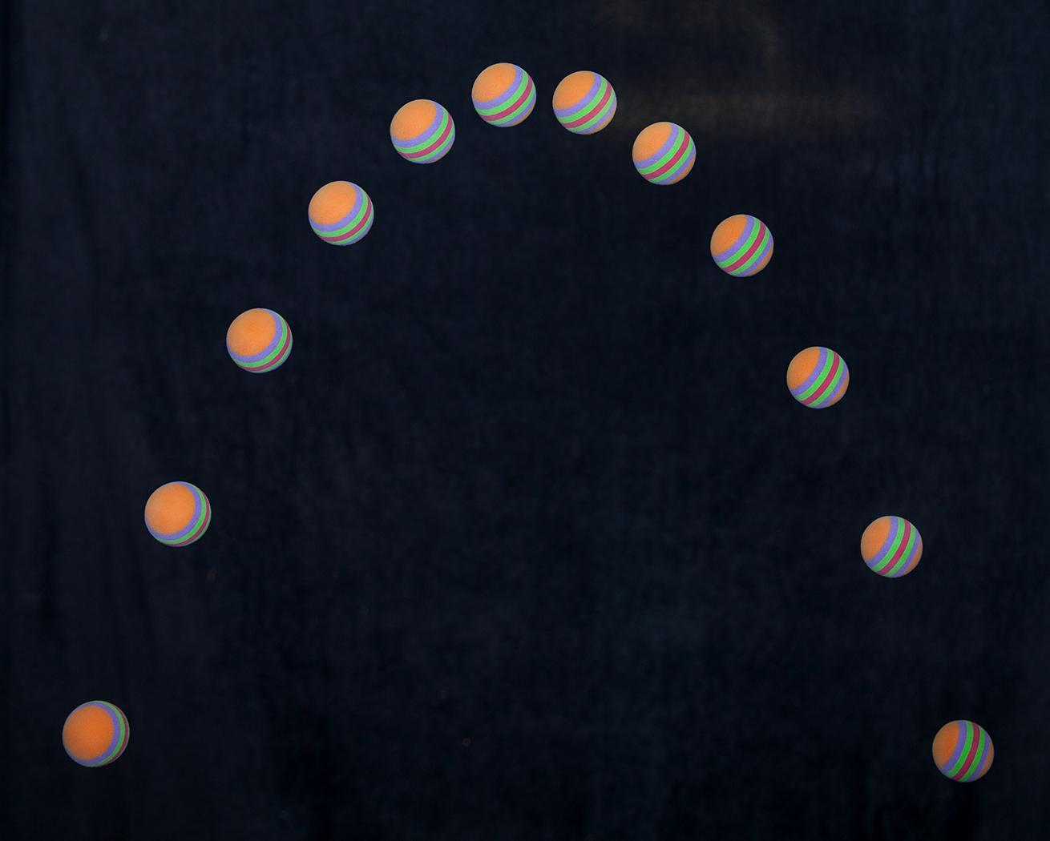
Allow: Time Lapse Multiple Exposure
III-4A: An example created in camera, no post production required (Jim)

Slide 19
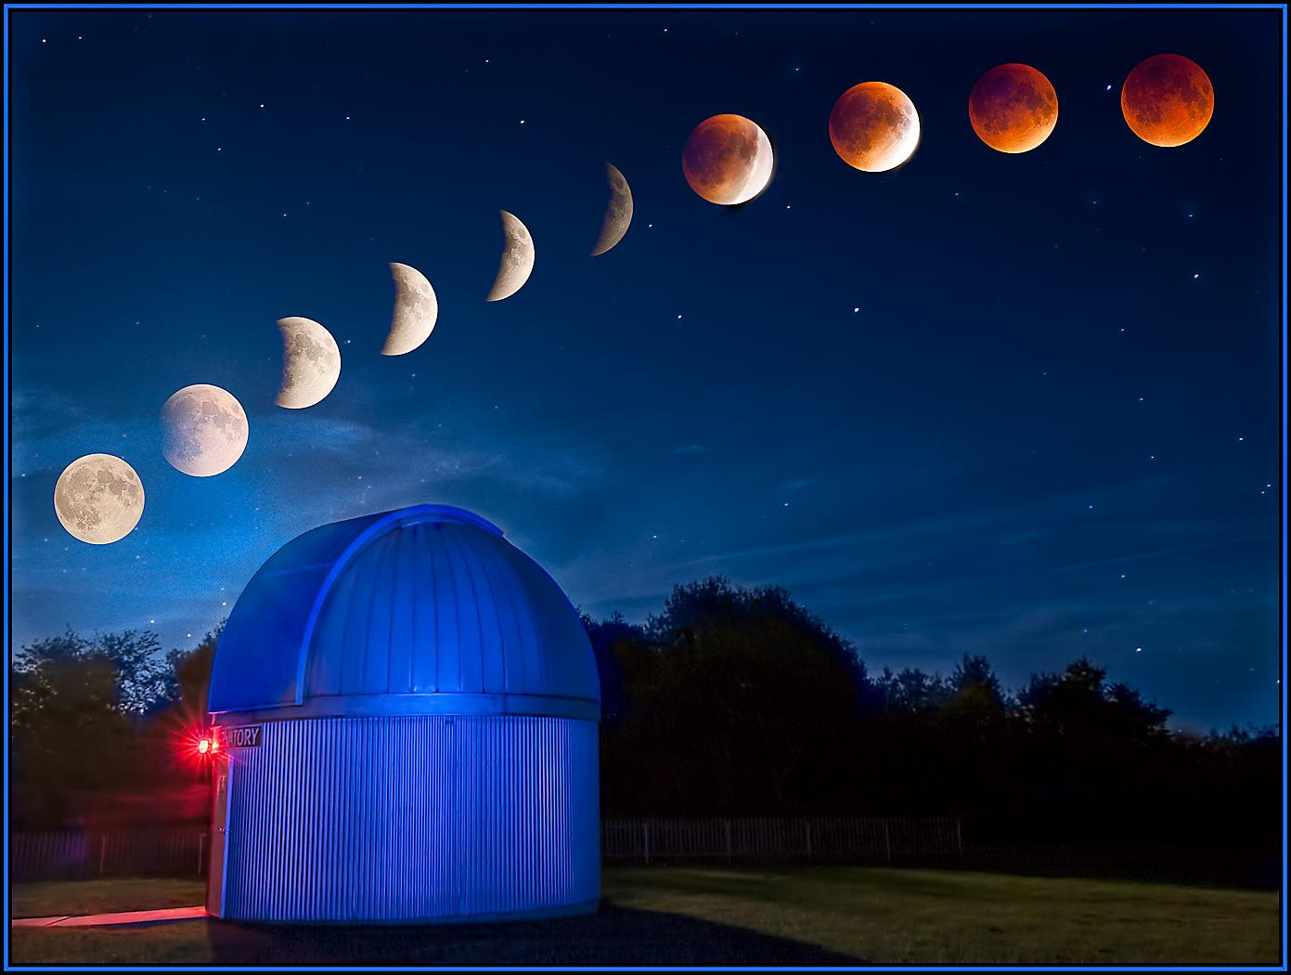
Allow: Time Lapse Multiple Exposure
III-4B: Time lapse multiple exposure blended in post production (Cindy)

Slide 20
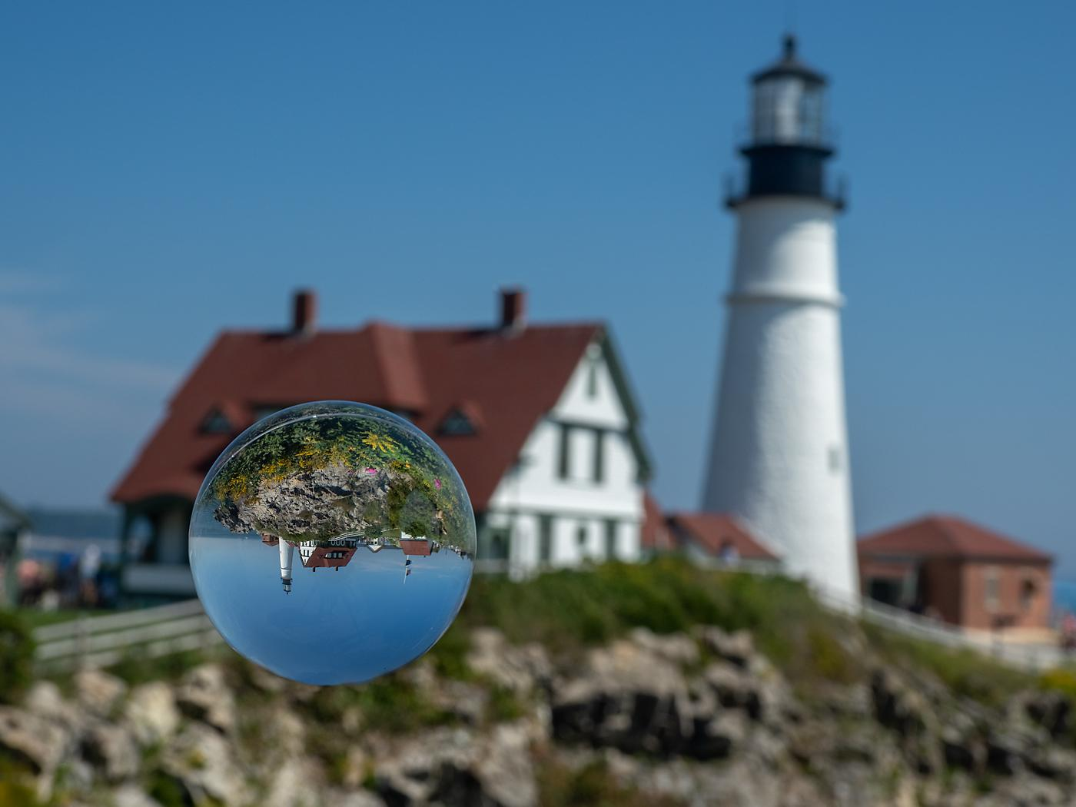
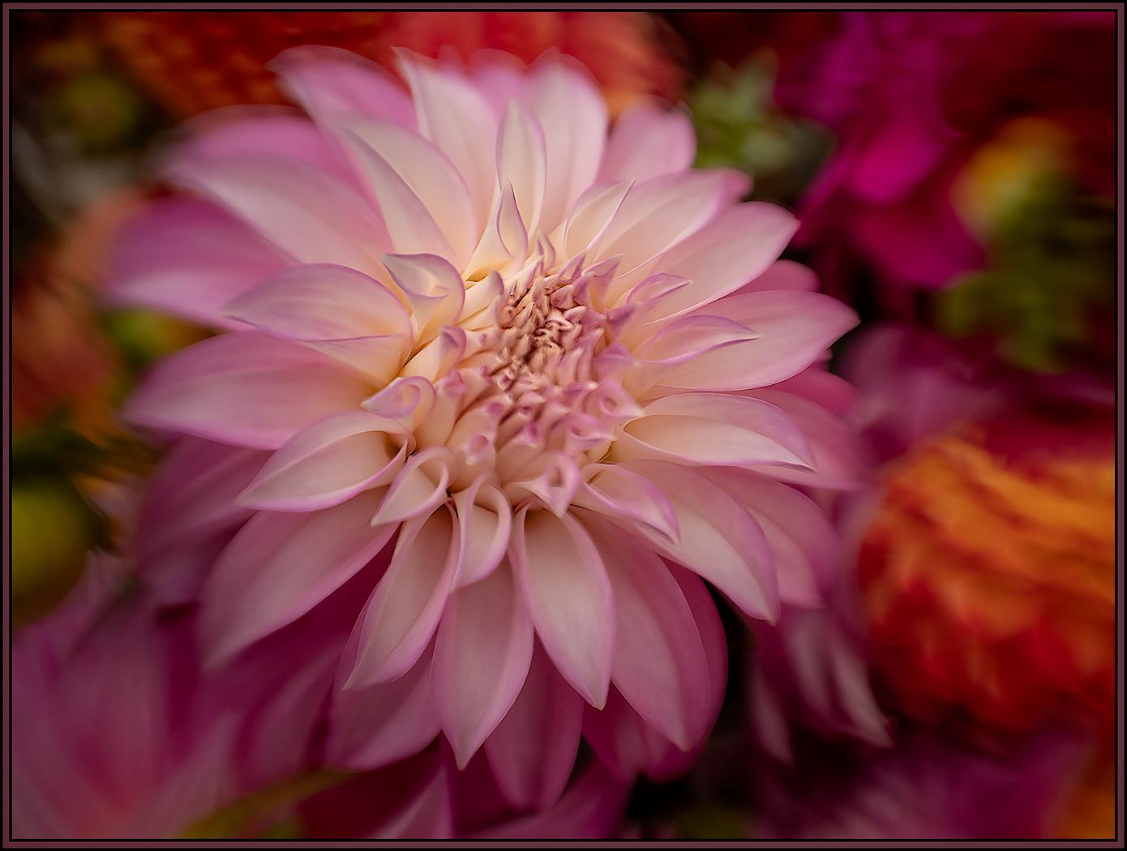
Allow: Light-Refracting Lens Attachments
III-5A: Light Ball and Lensbaby examples (Cindy)

Slide 21
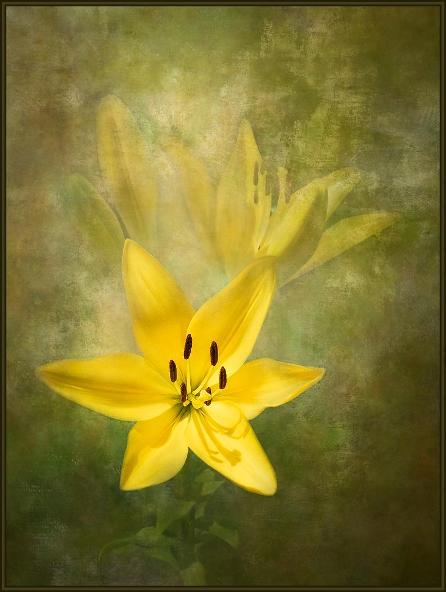
Allow: Textures IF They Are Created by the Maker
III-6A: Example of Textures Added to an Image (Cindy)

Slide 22
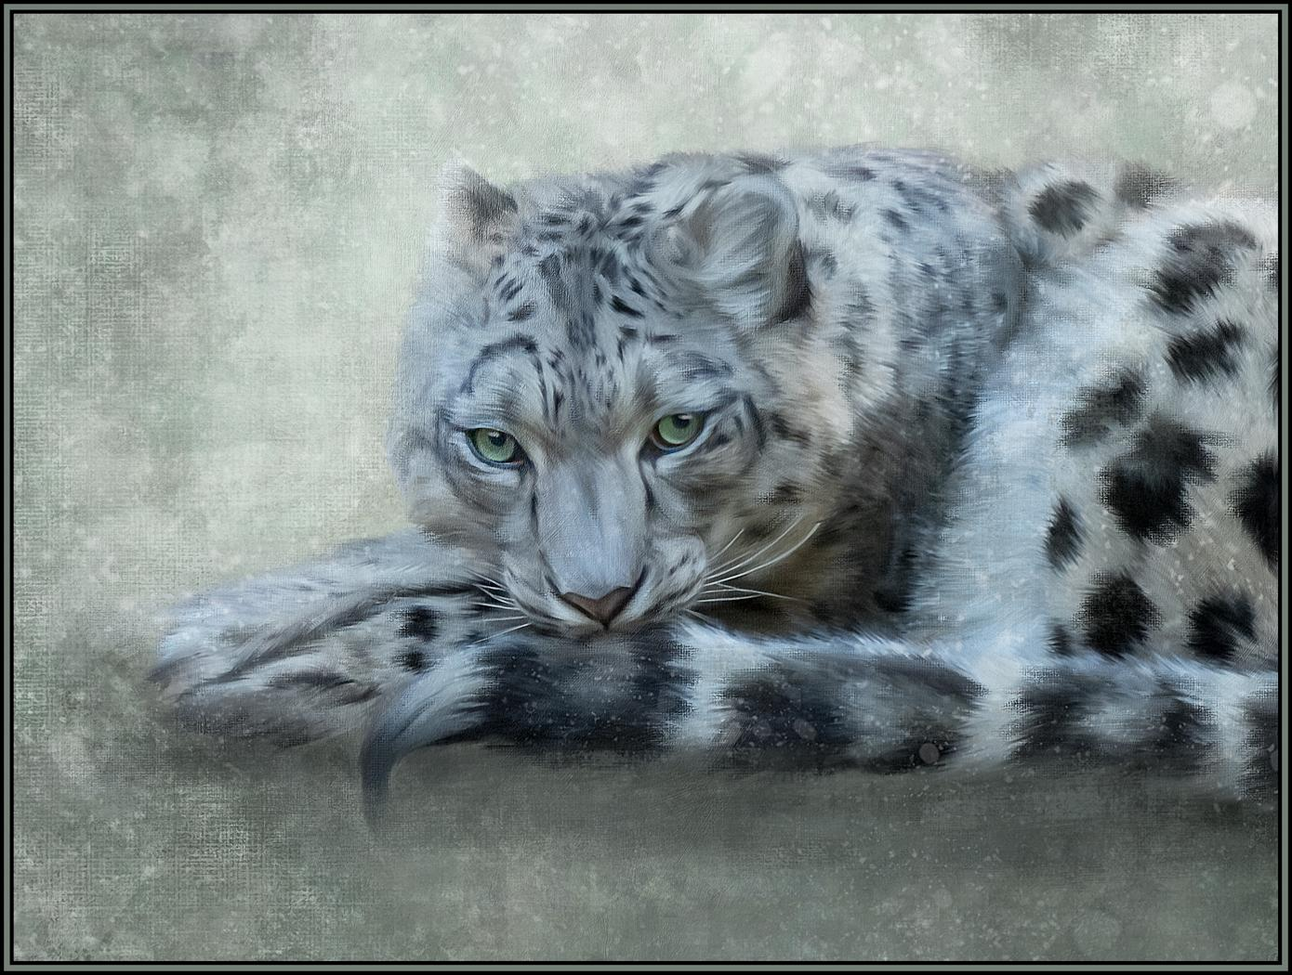
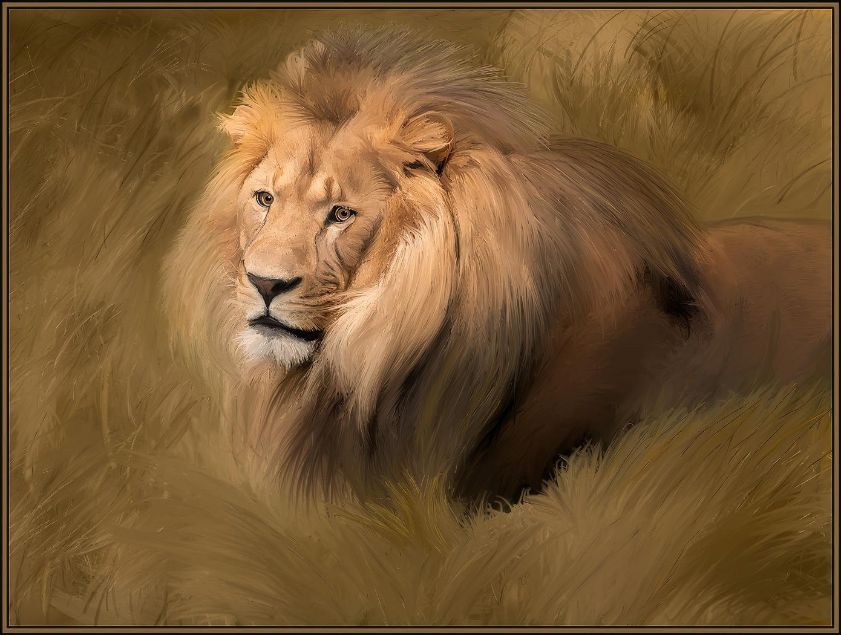
Allow: Painting Tools
III-7A: Requires the maker to choose color, placement, style, etc. (Cindy)

Slide 23
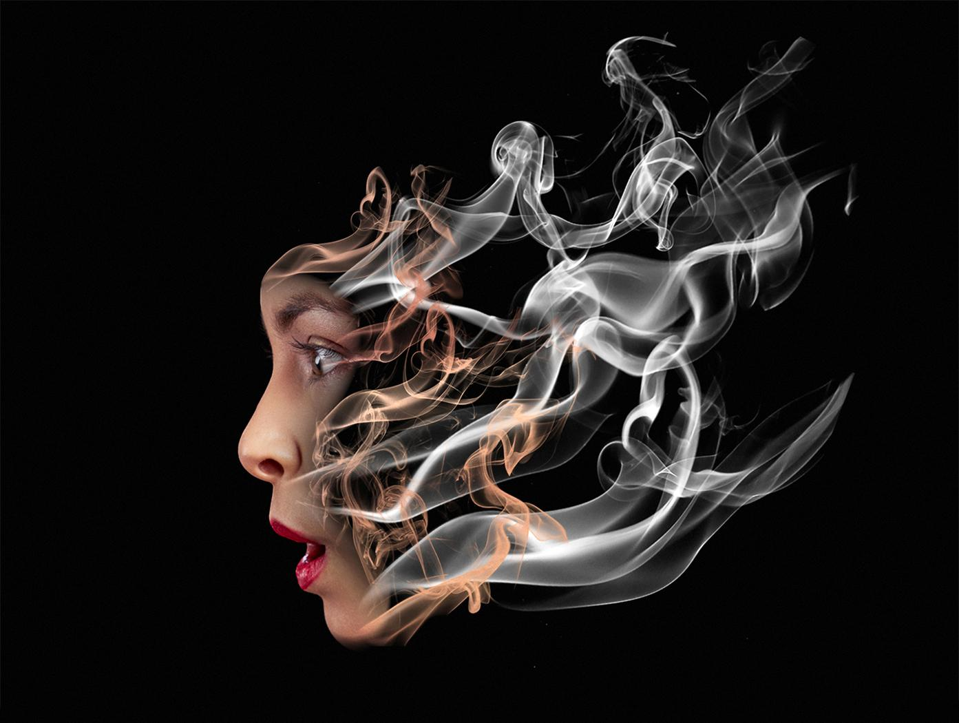
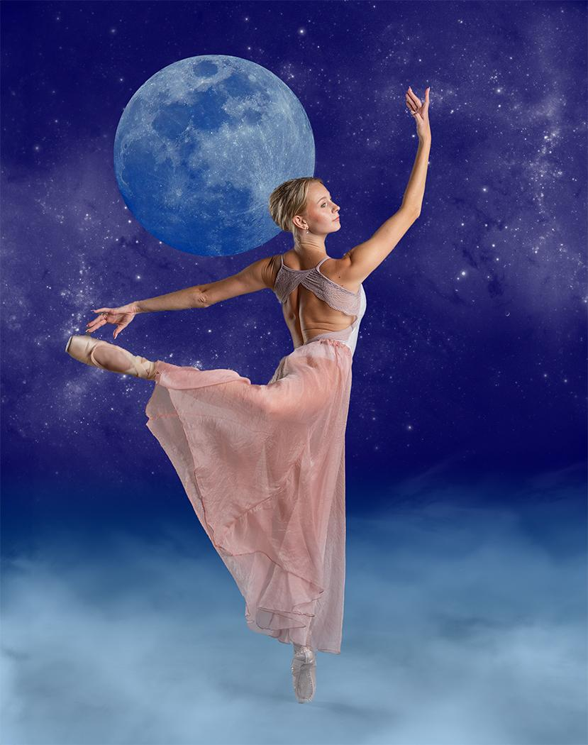
Allow: Brushes From Any Source
III-8A: Brushes require the maker to select style, color, position, lighting, etc. (Jim)

Slide 24
Allow: Composite Images…for Any Competition
To qualify for any competition a Composite Image must
Have all elements come from sources the maker created
Sky Replacement: be sky the maker has photographed
Generative Fill: fill using pixels from original image
Neural Filters: use only pixels from original image
Clip Art: come from images created by the maker
Textures: come from images created by the maker
Digital Frames: be created by the maker

Slide 25
For AR Competitions, Composites Images must also
no longer resemble something that our eyes and brains are used to seeing
display a change in natural color, form, shape, and/or other elements of the image
be obvious to the viewer that these changes have occurred
Allow: Composite Images for AR Competition

Slide 26

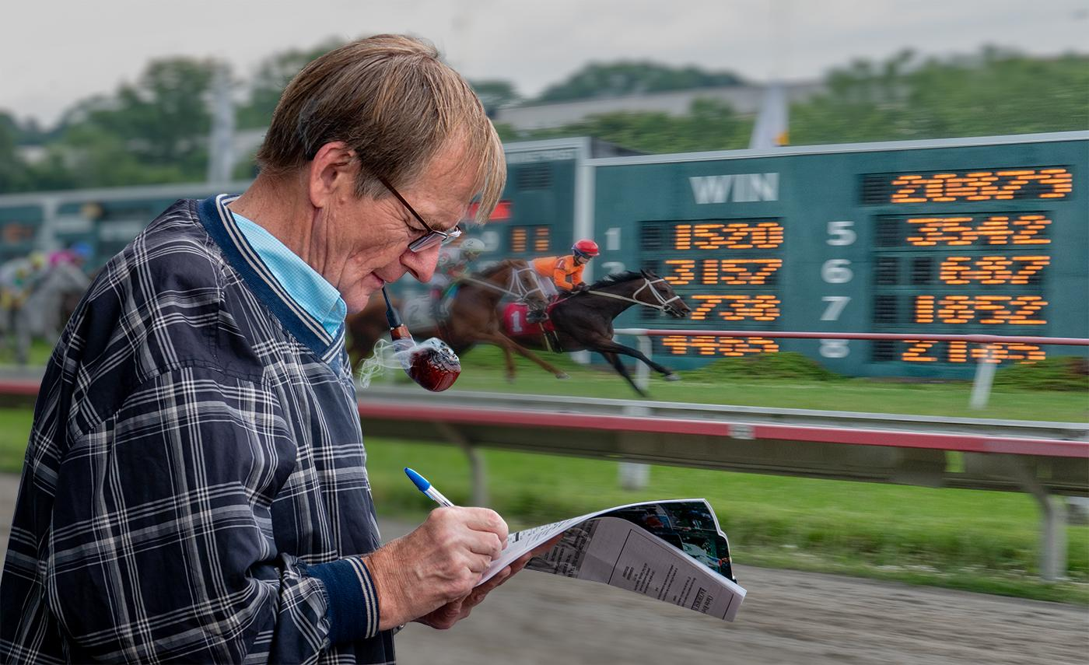
Do Not Allow: Composites That Look Realistic
III-9Aa: Composites that look realistic should NOT be allowed (Jim, Rick Cloran)

Slide 27
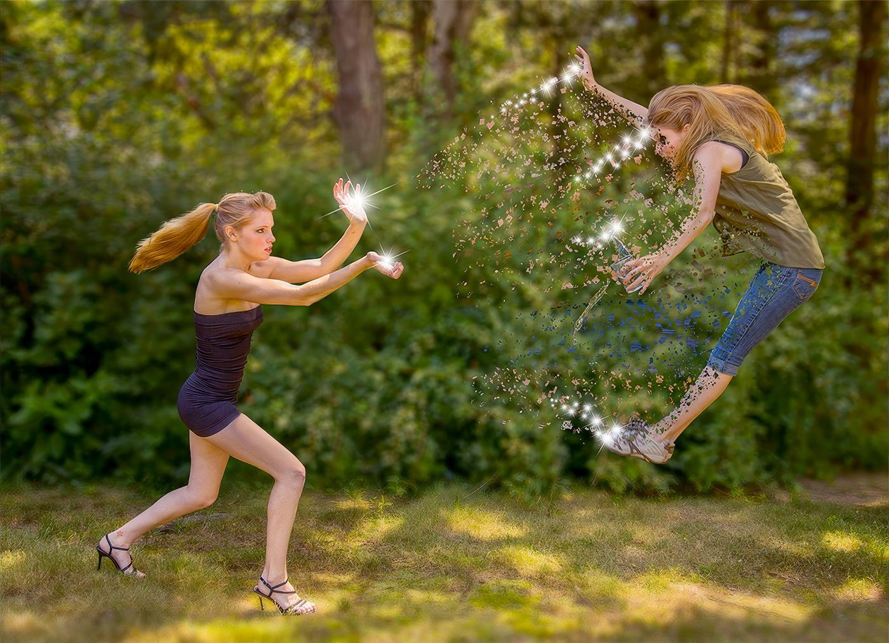
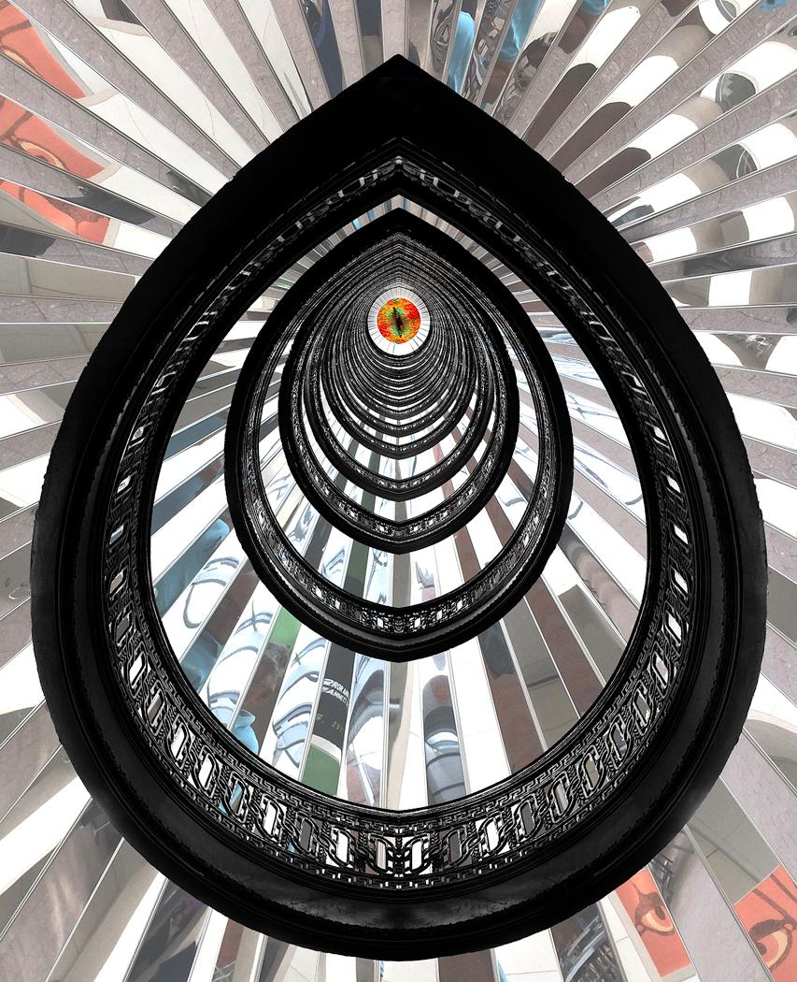
But Do Allow: Composites With Obvious Alterations
III-9Ab: AR Composites - change must be obvious to viewer (Jim, Rick)

Slide 28
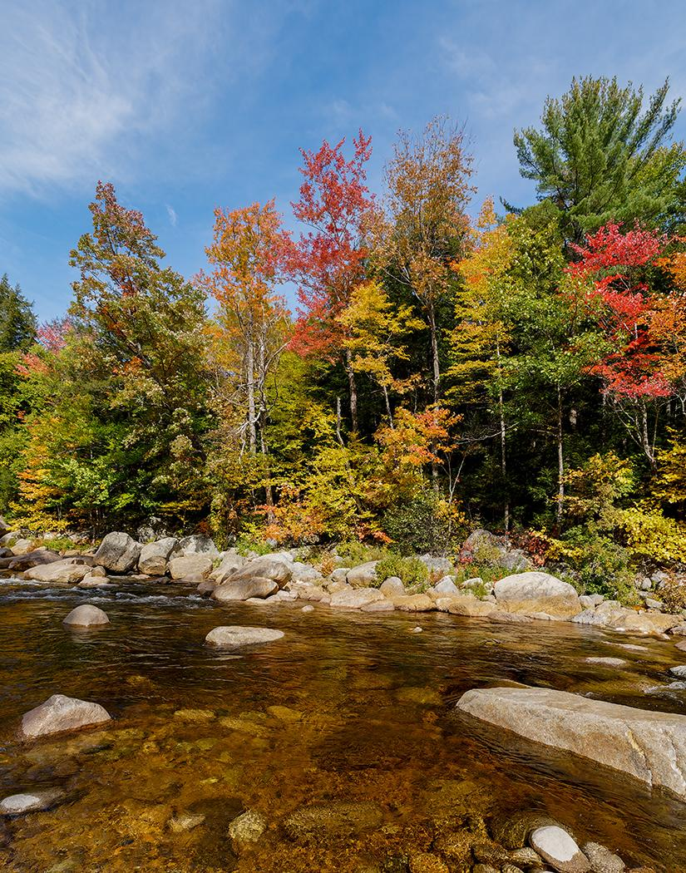
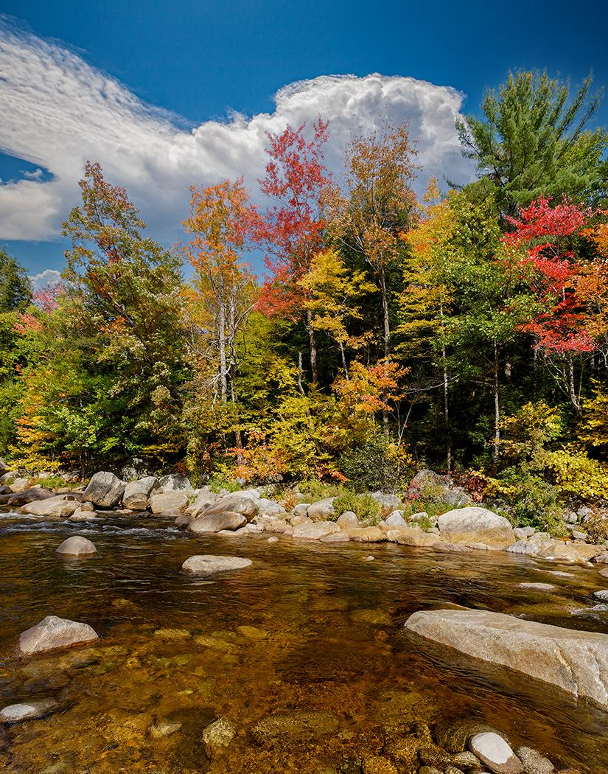
Do Not Allow: Sky Replacement (by itself)
IV-2A&B: Most sky replacements look realistic (Jim)

Slide 29
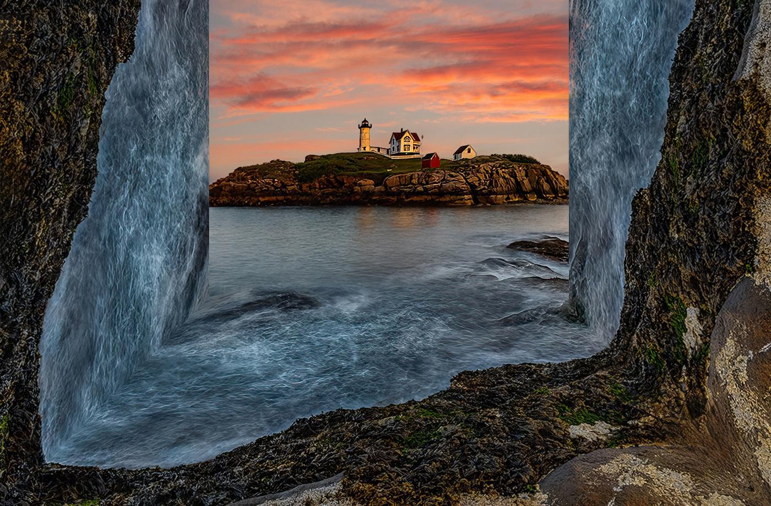
But Do Allow: Sky Replacement as part of AR image
IV-2b: The sky has been replaced in this AR Image (Rick)

Slide 30
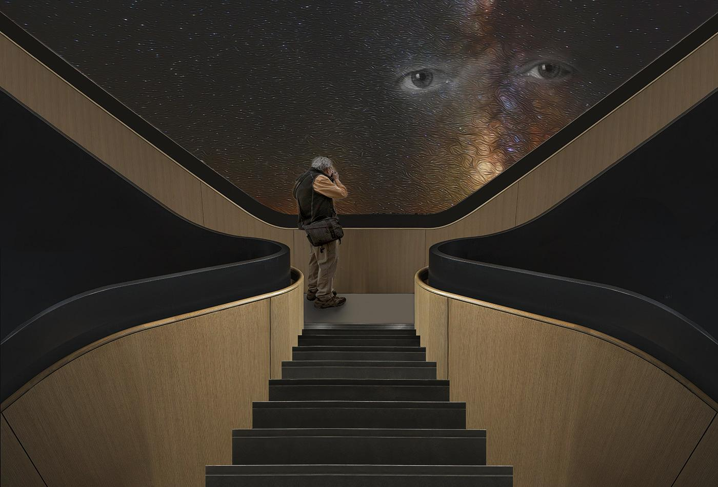
But Do Allow: Sky Replacement as part of AR image
IV-2c: Sky Replacement actually makes this an AR image (Ken Jordan, Frank Forward)

Slide 31
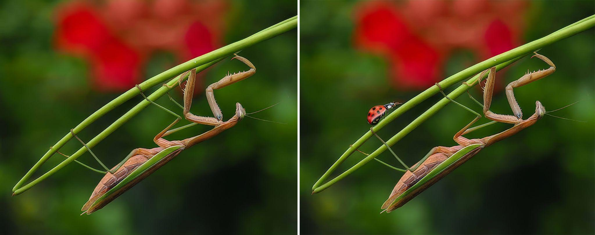
Do Not Allow: Generative Fill Adding Outsourced Elements
III-9Da&b: Added the Lady Bug…not using pixels from original image (Lisa)
Also…are these Altered Reality images?

Slide 32
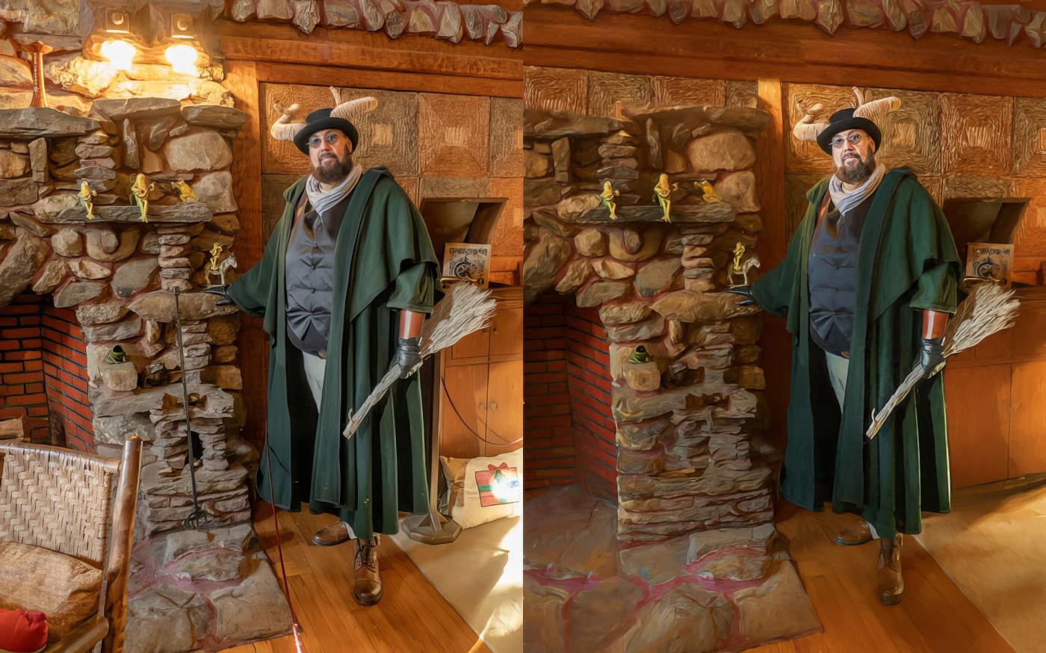
But Do Allow: Generative Fill Using Pixels From Image
III-9Db: Pixels from original image removed distractions (Lisa)
And…are these Altered Reality images?

Slide 33
Do Not Allow: Neural Filters Adding Outsourced Elements
Similar to Generative Fill, Neural Filters can use pixels from your own image, or pixels sourced from images from third parties
In order to be eligible ANY competition, Neural Filters must use ONLY pixels that originate from the original image
Much of the time, a viewer can’t tell if a Neural Filter used outsourced pixels
Just as in Nature, Photojournalism, etc. we must rely on the integrity of the maker to be truthful
Software companies are working on a way to indicate if outsourced images have been added to an image

Slide 34
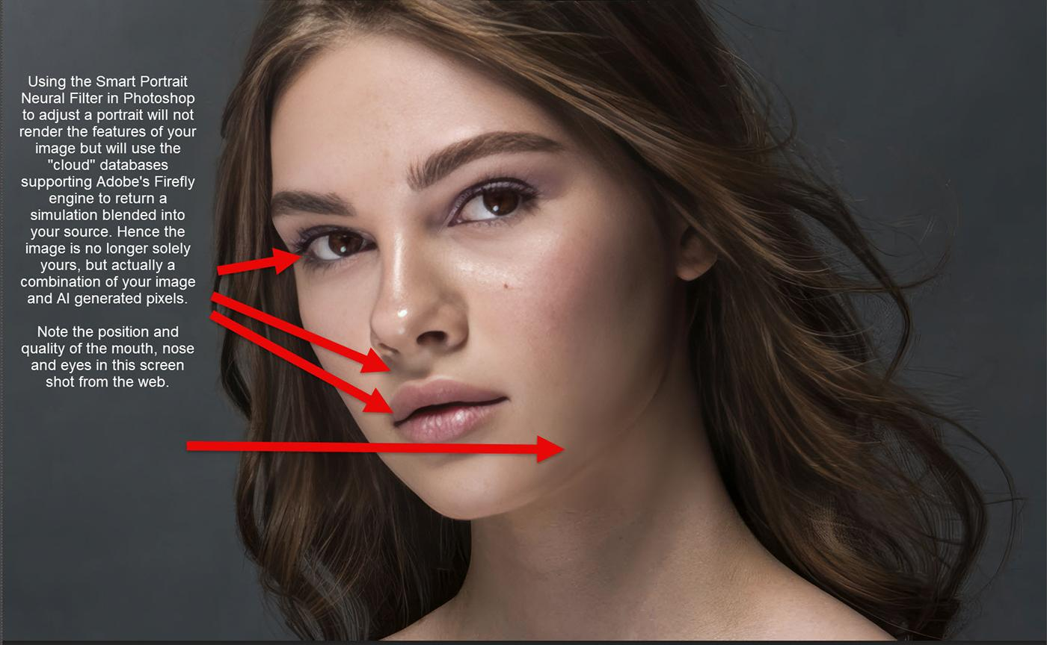
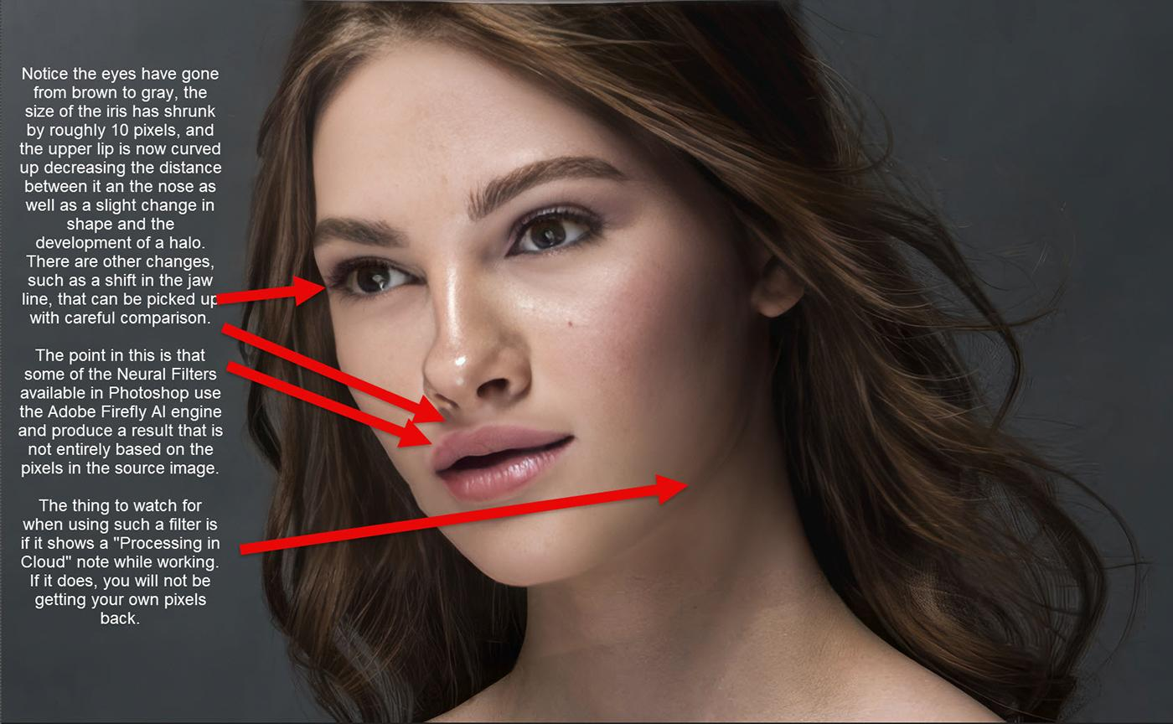
Do Not Allow: Neural Filters That Add Outsourced Elements
III-9Db: Neural Filters can add pixels from third party sources (Rick)

Slide 35
Part Three: Suggestions For
Tools and Techniques NOT to Allow

Slide 36
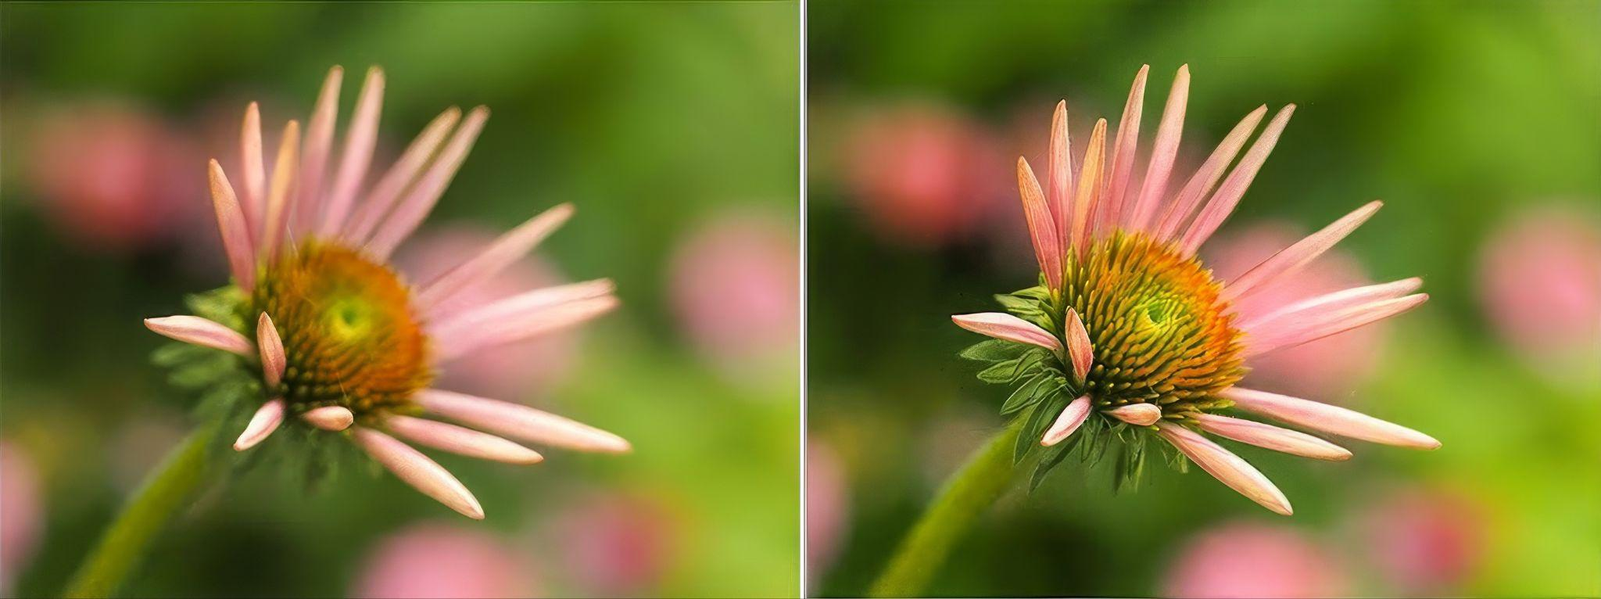
Do Not Allow: Focus Stacking (by itself)
IV-1: But, focus stacking could be PART of an AR image (Lisa)

Slide 37
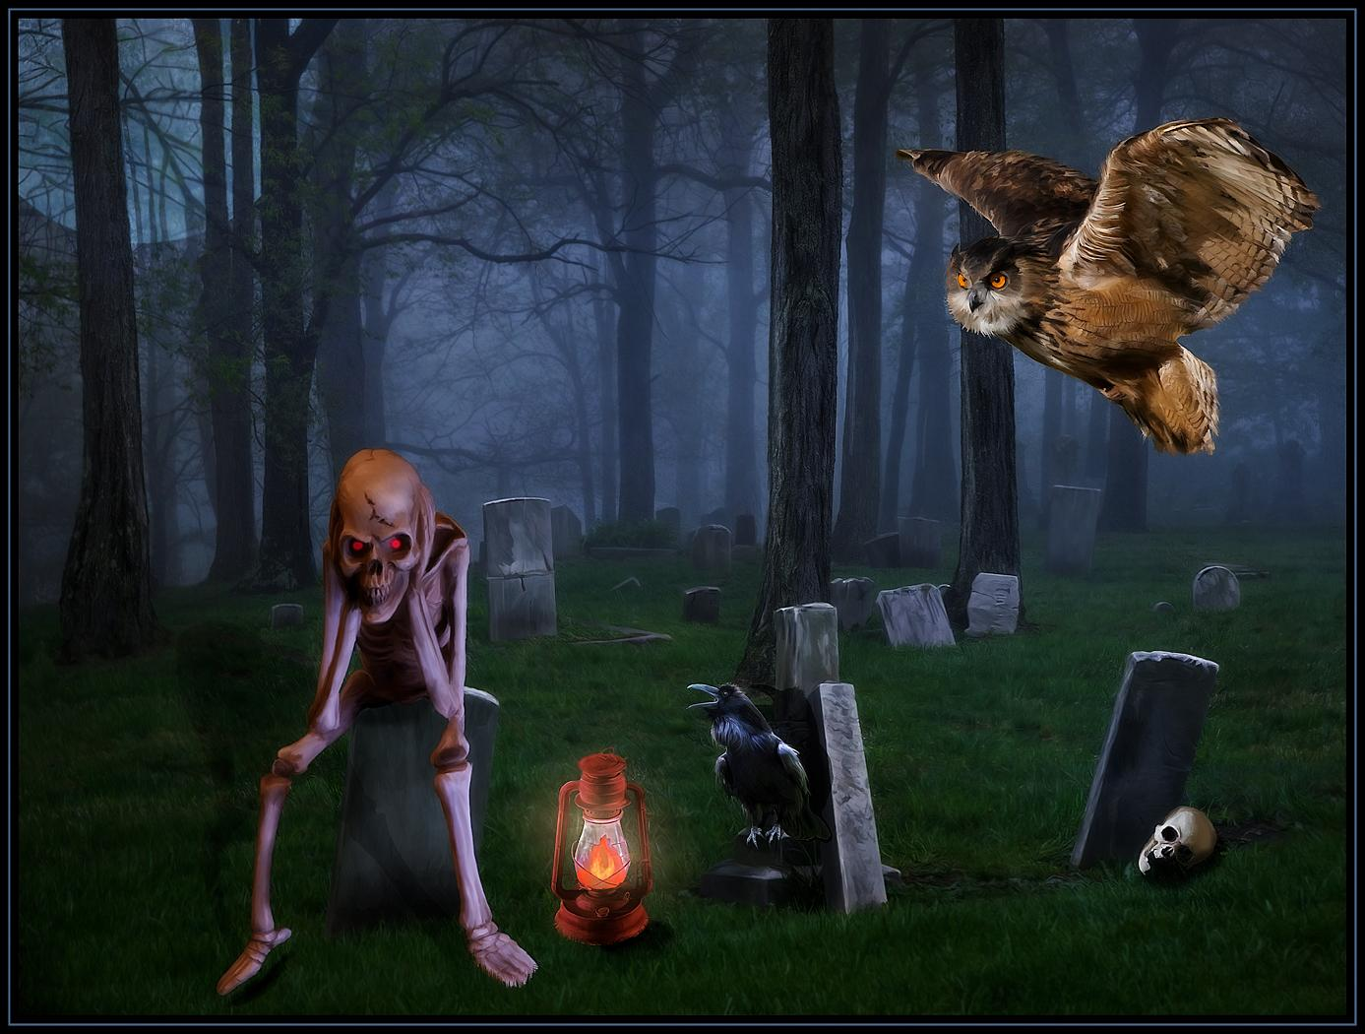
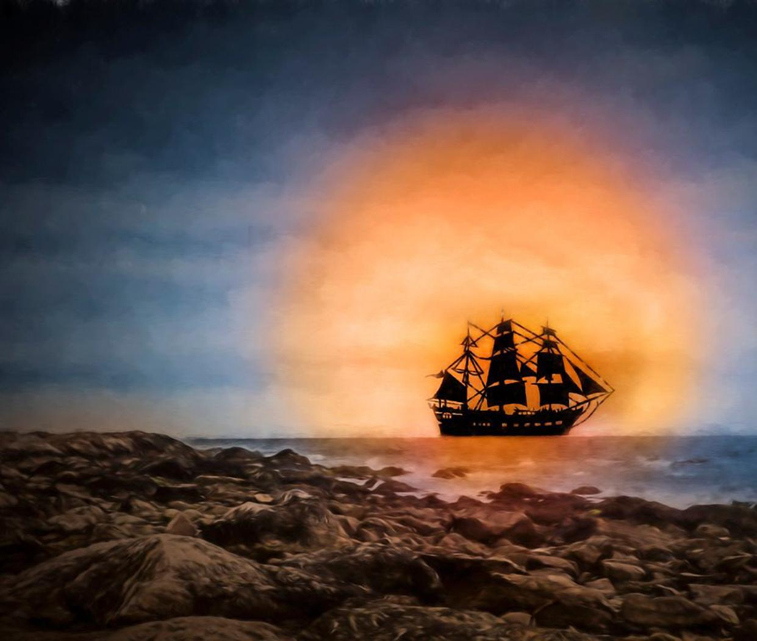
Do Not Allow: Clip Art From Third Party Source
IV-2: Must be created by the maker (Cindy), not sourced from third party (Lisa)

Slide 38

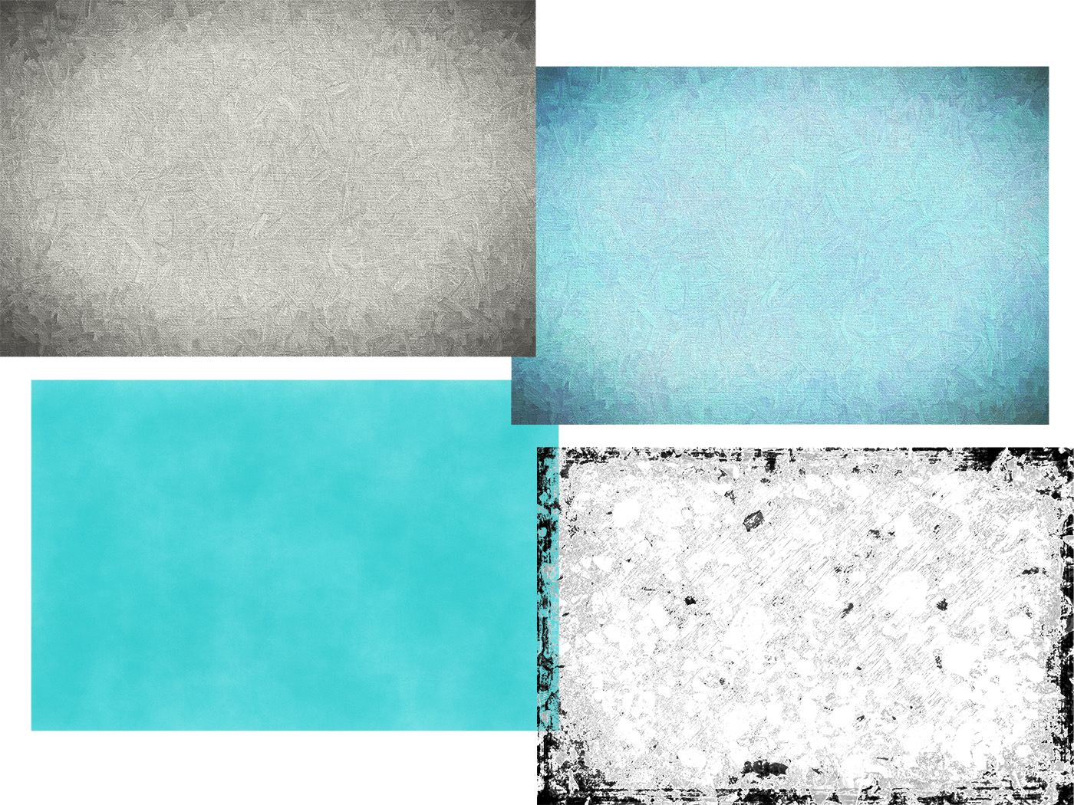
Do Not Allow: Textures Sourced From Any Third Party
IV-3: Textures need to be created by the maker (Hazel Meredith)

Slide 39
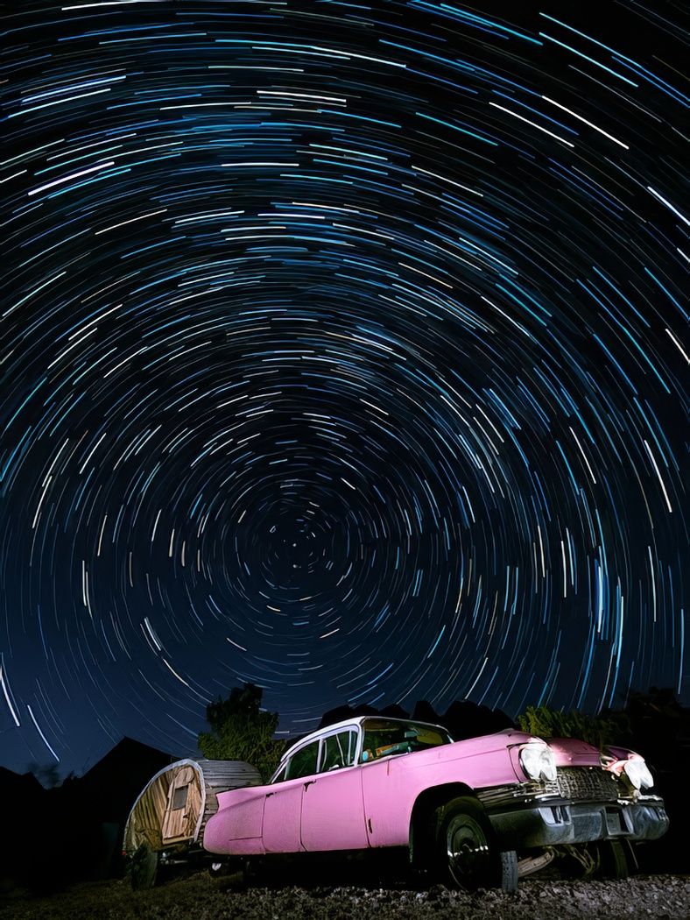
Do Not Allow: Star Trails Image (by Itself)
IV-4a: Star Trails have become commonplace therefore not AR (Lisa,)

Slide 40
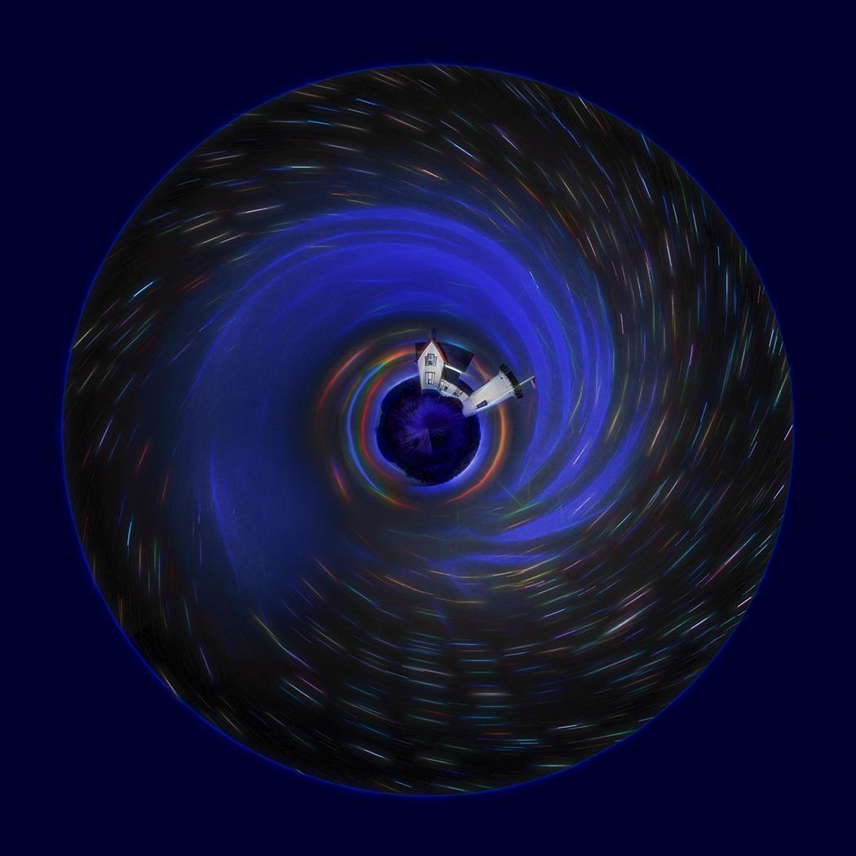
But Do Allow: Star Trails as Part of an AR image
IV-4b: Star Trails as part of an AR image are OK (Lisa)

Slide 41
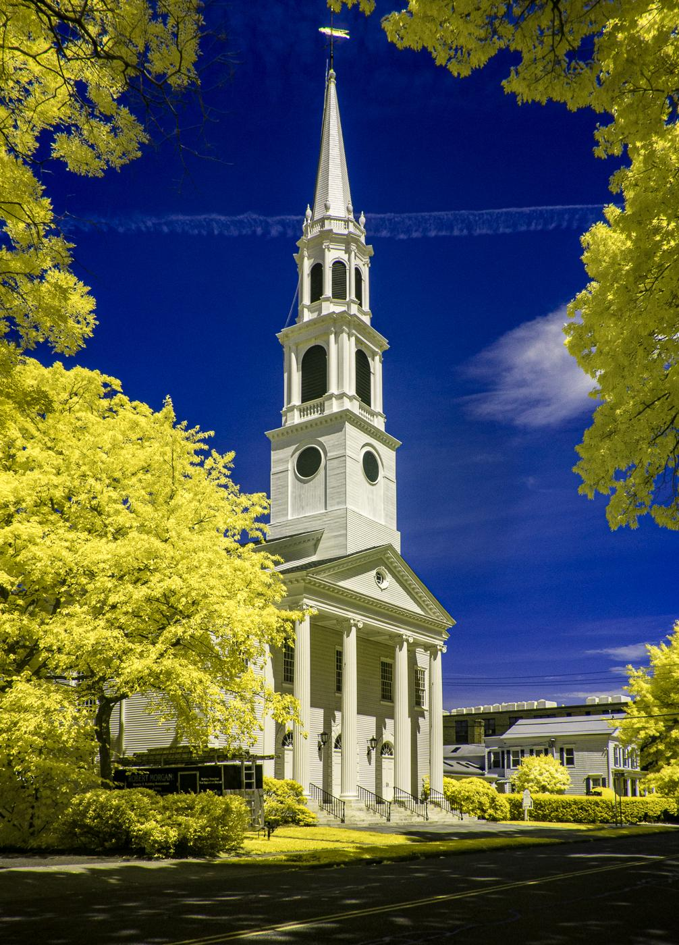
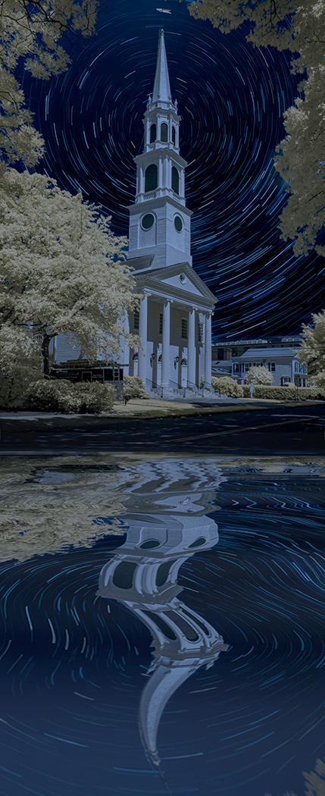
Do Not Allow: Infrared (IR) Images By Themselves
IV-5: IR by itself is commonplace; IR in an AR image is OK (Bill, Lisa, Jim)

Slide 42
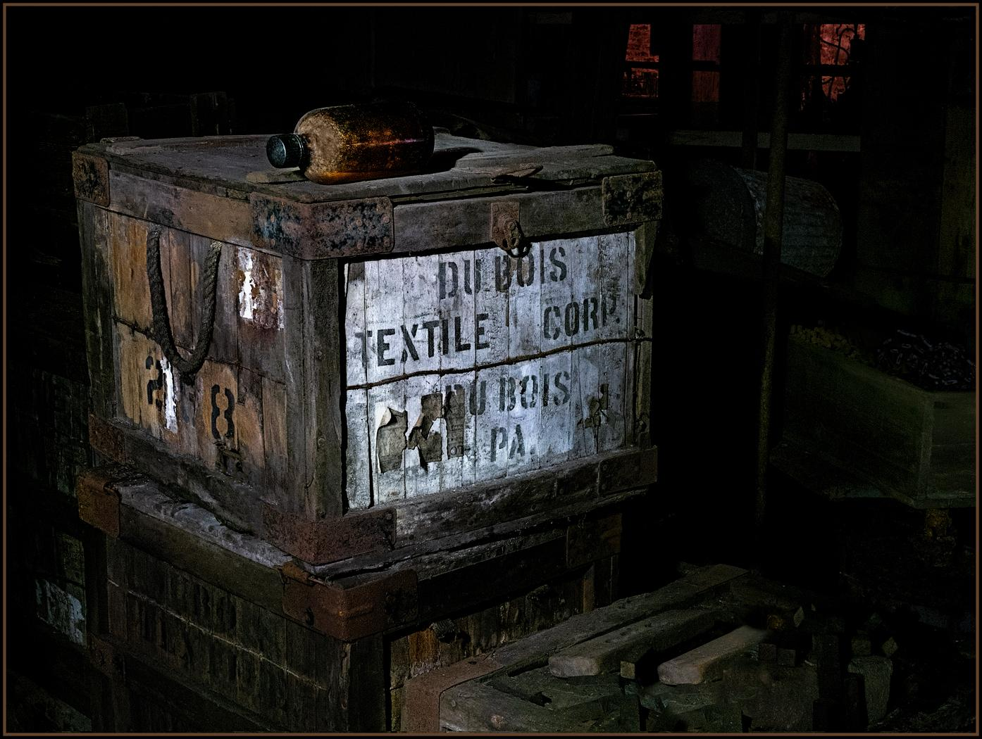
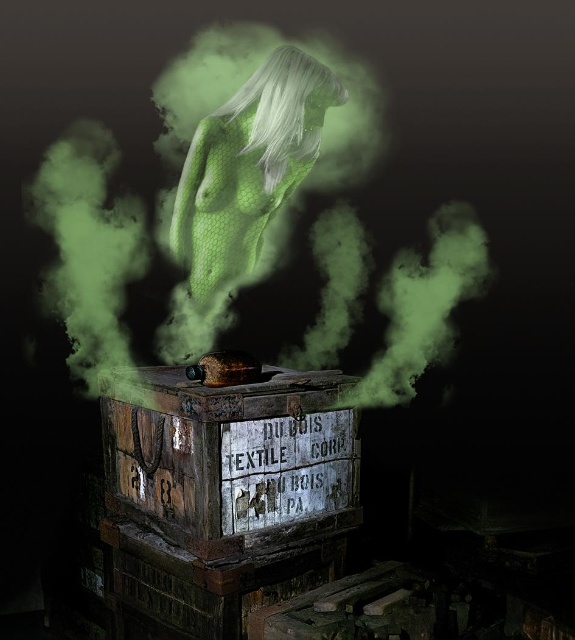
Do Not Allow: Light Painting (by itself)
IV-6: Light painting can be part of an AR image (Cindy, Jim)

Slide 43
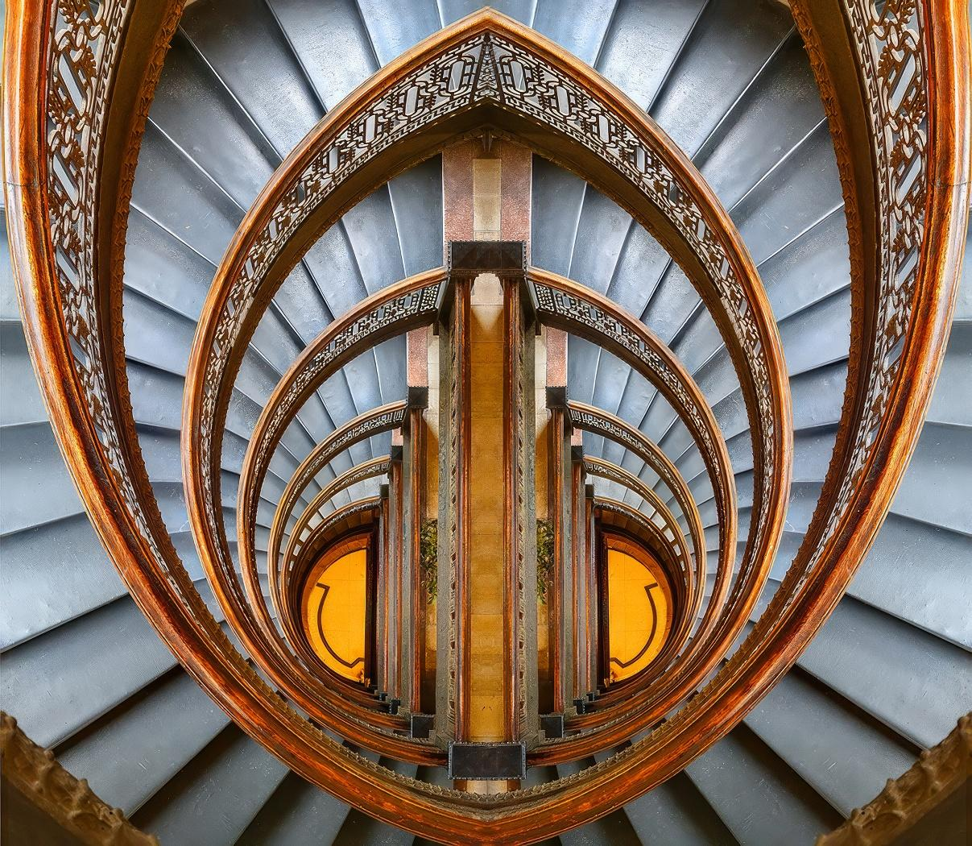
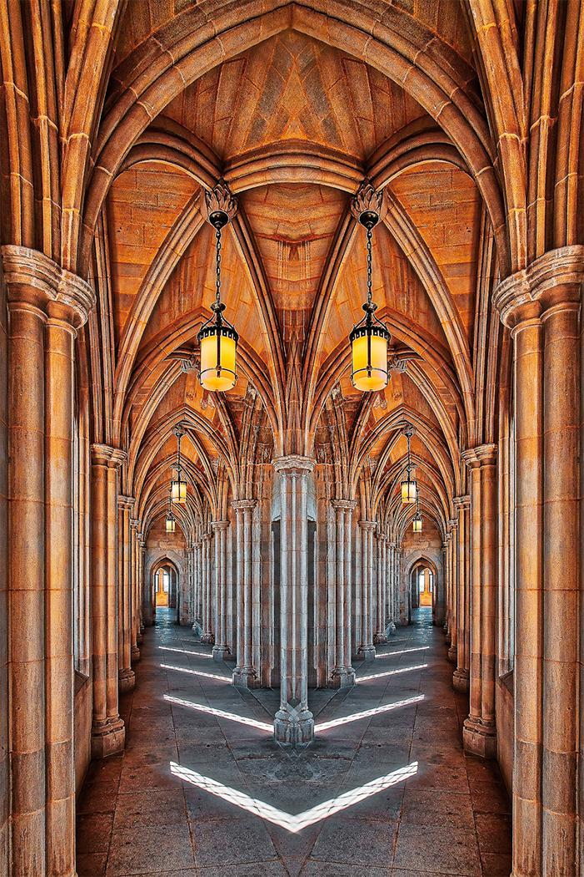
Do Not Allow: High Dynamic Range (HDR) By Itself
IV-7: HDR by itself does not make an image AR (Rick)

Slide 44
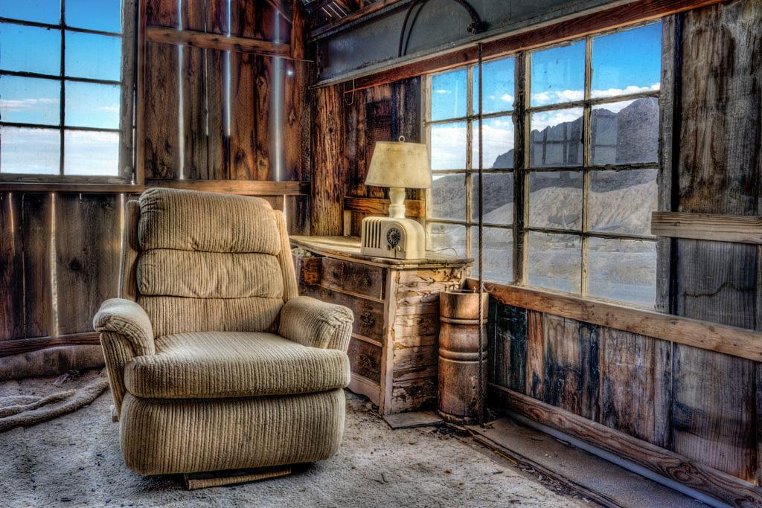
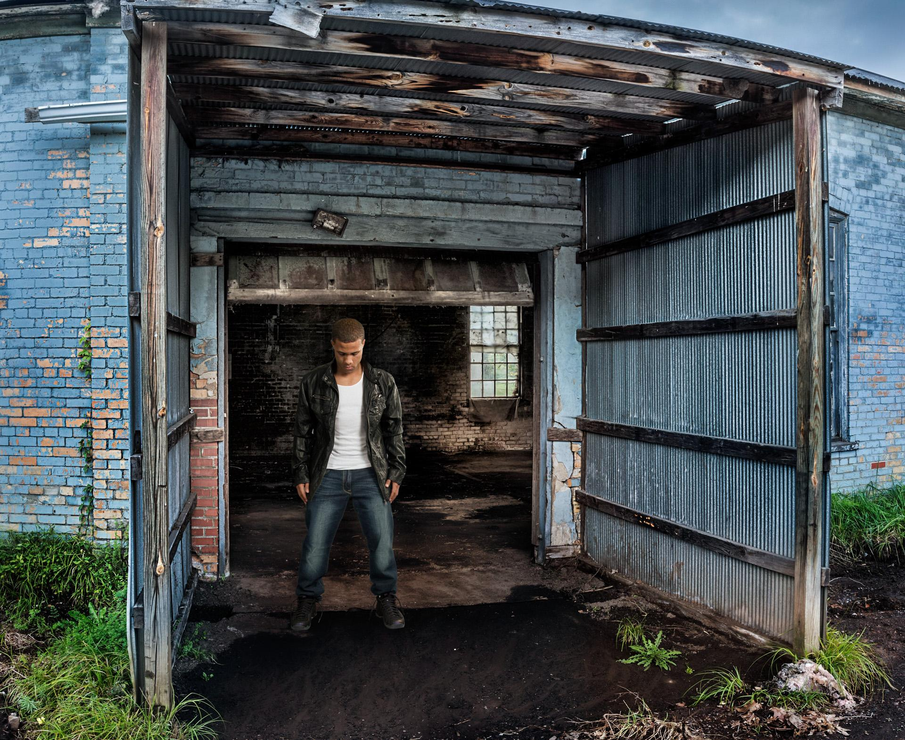
Do Not Allow: High Dynamic Range (HDR) By Itself
IV-7: More examples of HDR (tone mapped) images not AR (Lisa)

Slide 45
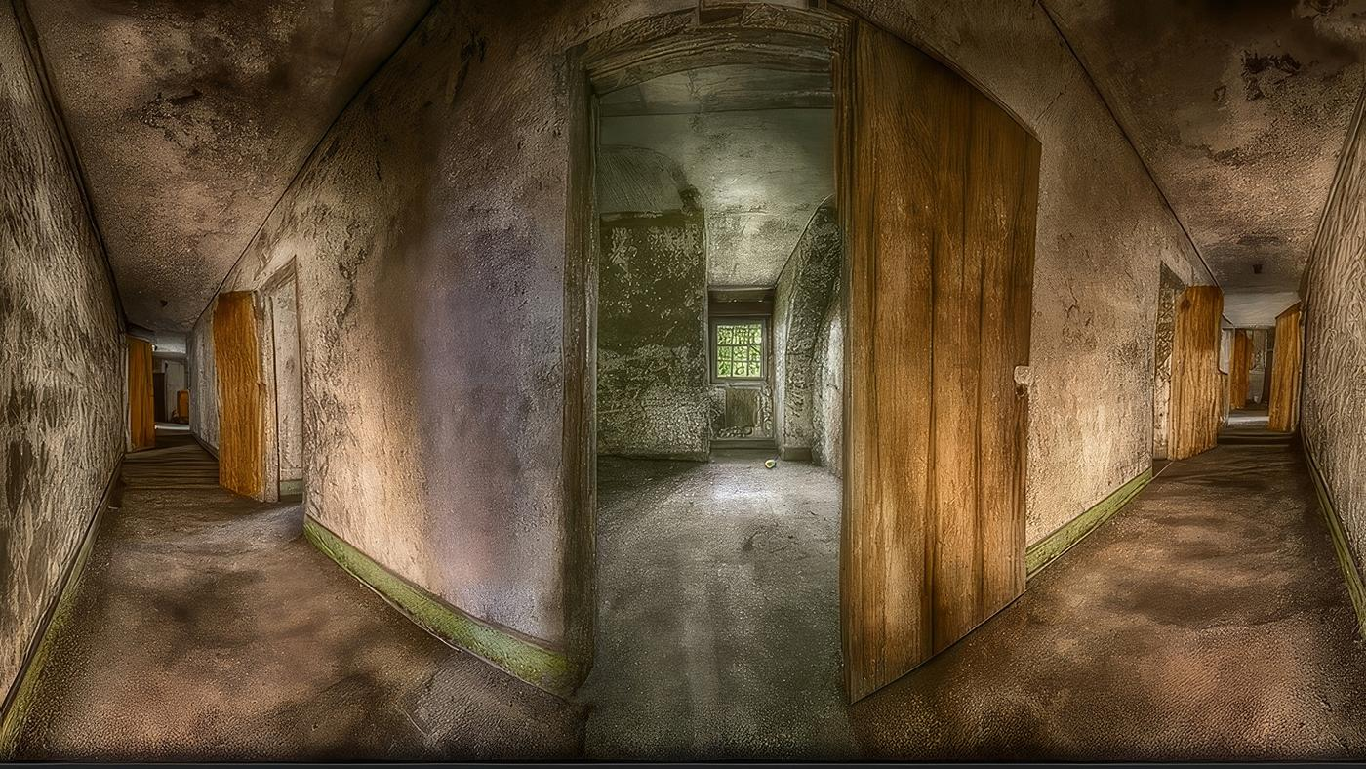
Do Not Allow: Panoramic Images (by themselves)
IV-8: Non-AR Panorama - (Lisa)

Slide 46
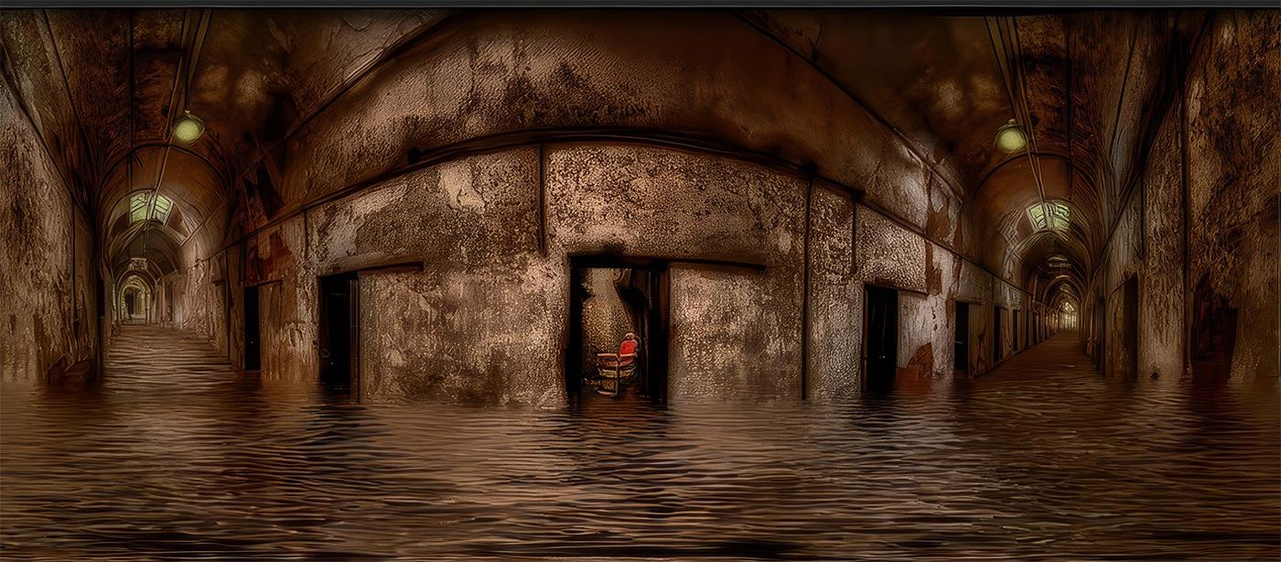
But Do Allow: Panoramic Images Converted to AR
IV-8: The flood effect can make a Panorama an HDR image (Lisa)

Slide 47
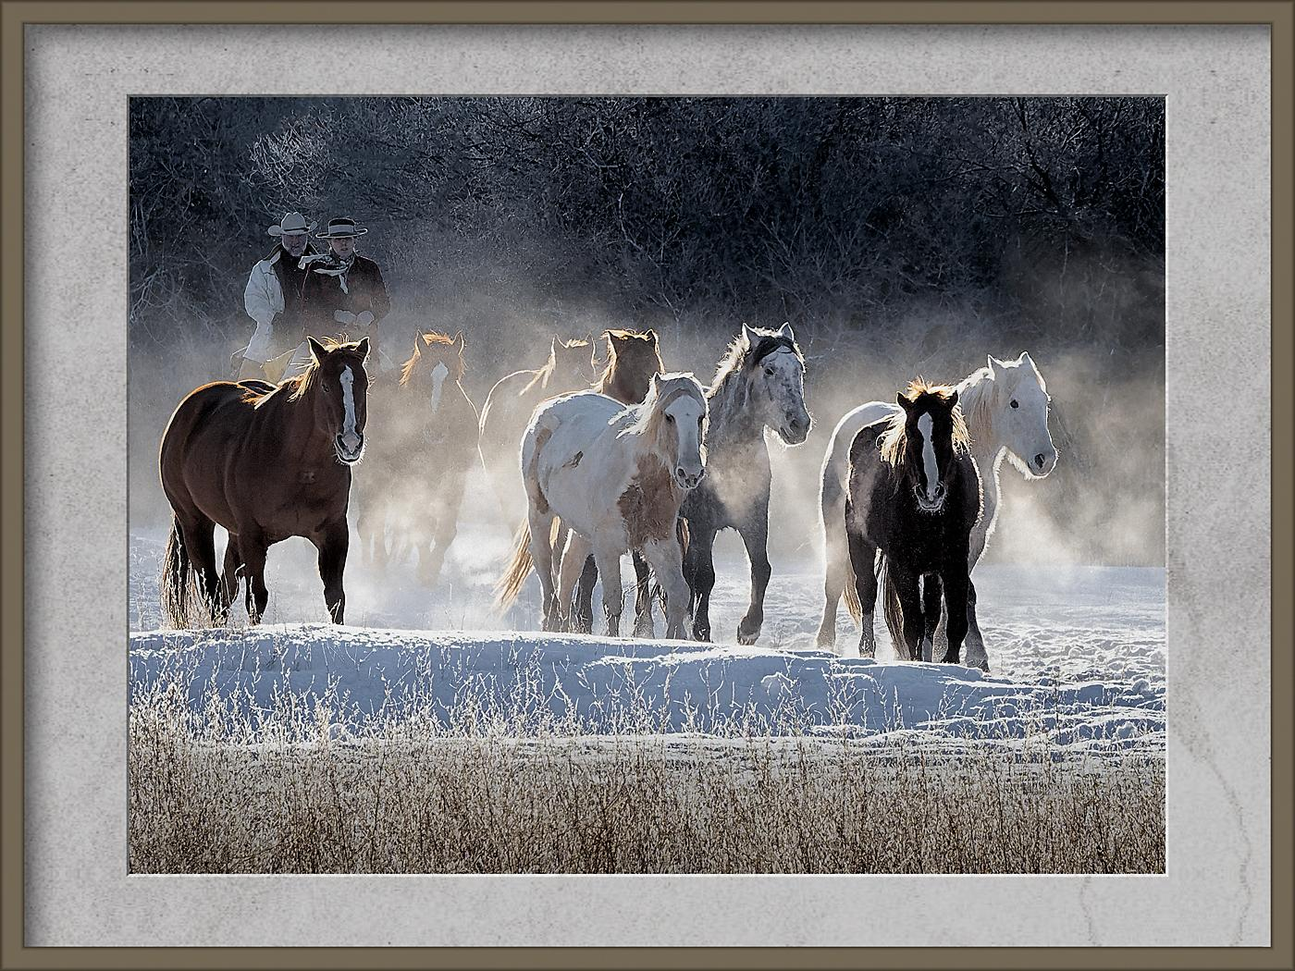
Do Not Allow: Digital Frames Added To Non-AR Images
IV-9: Digital Frame by itself does not make an AR image (Cindy)

Slide 48
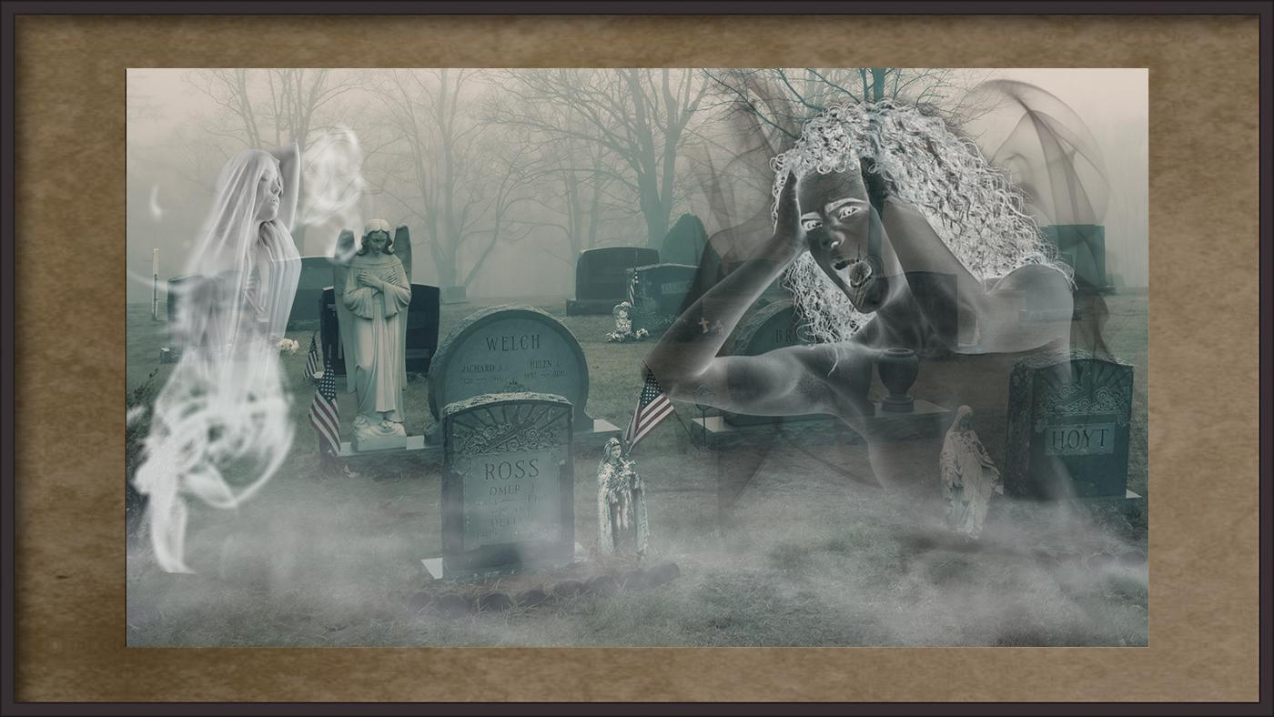
But Do Allow: A Digital Frame Around An AR Image
IV-9: AR image surrounded by digital frame (Cindy, Jim)

Slide 49
Summary: Determine If An Image Should Be Allowed
Does the image use a technique or tool that your rules
state is not allowed?
  If Yes - should NOT be allowed
  If No - Image can be allowed
Is the image no longer a TRUE AND REALISTIC
REPRESENTATION OF REALITY?
  If No - should NOT be allowed (it still looks realistic)
  If Yes - Image can be allowed
Is it immediately OBVIOUS that the image is no longer what our eyes and brains are used to seeing?
  If NO - should NOT be allowed (viewer has to struggle to determine if unrealistic)
  If Yes - Image can be allowed

Slide 50
Thank you for your attention.
We hope this presentation has been helpful toward your efforts to develop AR competitions.

Slide 51
Stay Tuned!
A Separate Presentation Will Cover Suggestions to Help Develop Judging Instructions for AR Competitions

